Slide 1
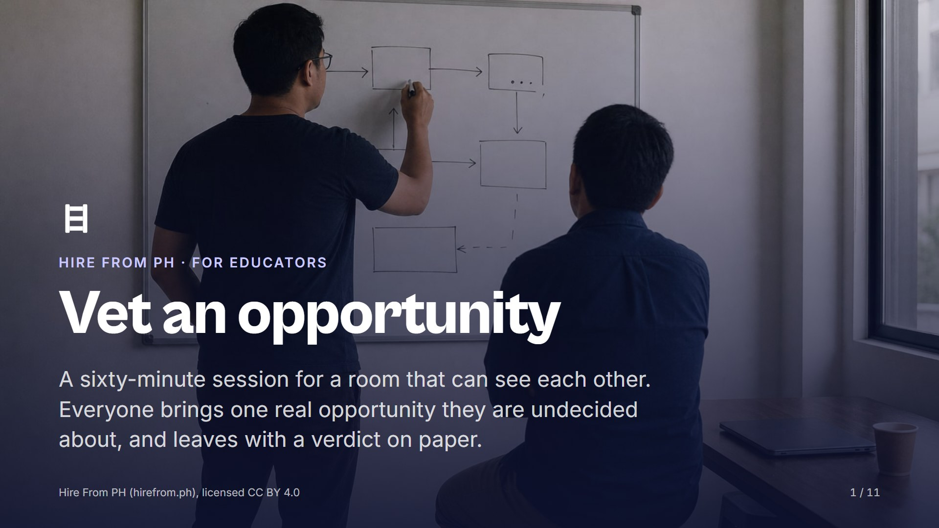
Notes:
Open on this slide while people find a seat in the circle or the horseshoe; they need to see each other for the argument and the admission this session runs on. Check that everyone has their opportunity to hand, and pair anyone who forgot with someone who did not. Say plainly that nobody gets shamed in this room, and that everyone here has said yes too quickly at least once.

Slide 2
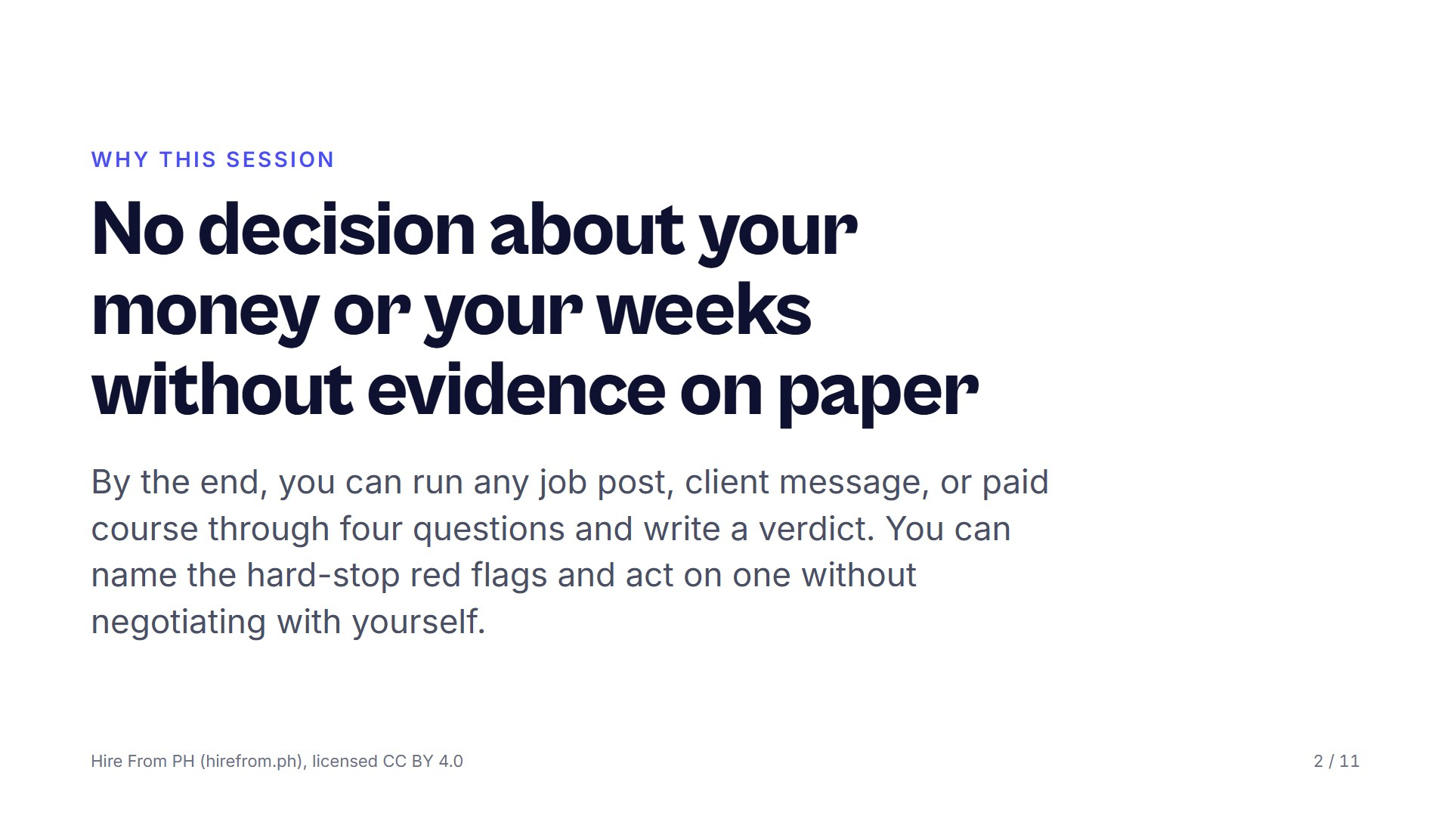
Notes:
Ask what a bad yes costs: weeks of unpaid work, a fee that never comes back, personal documents sitting in a stranger's inbox. Take three answers and correct none of them. Then read the three objectives and say that the habit, not the checklist, is what they are taking home.

Slide 3
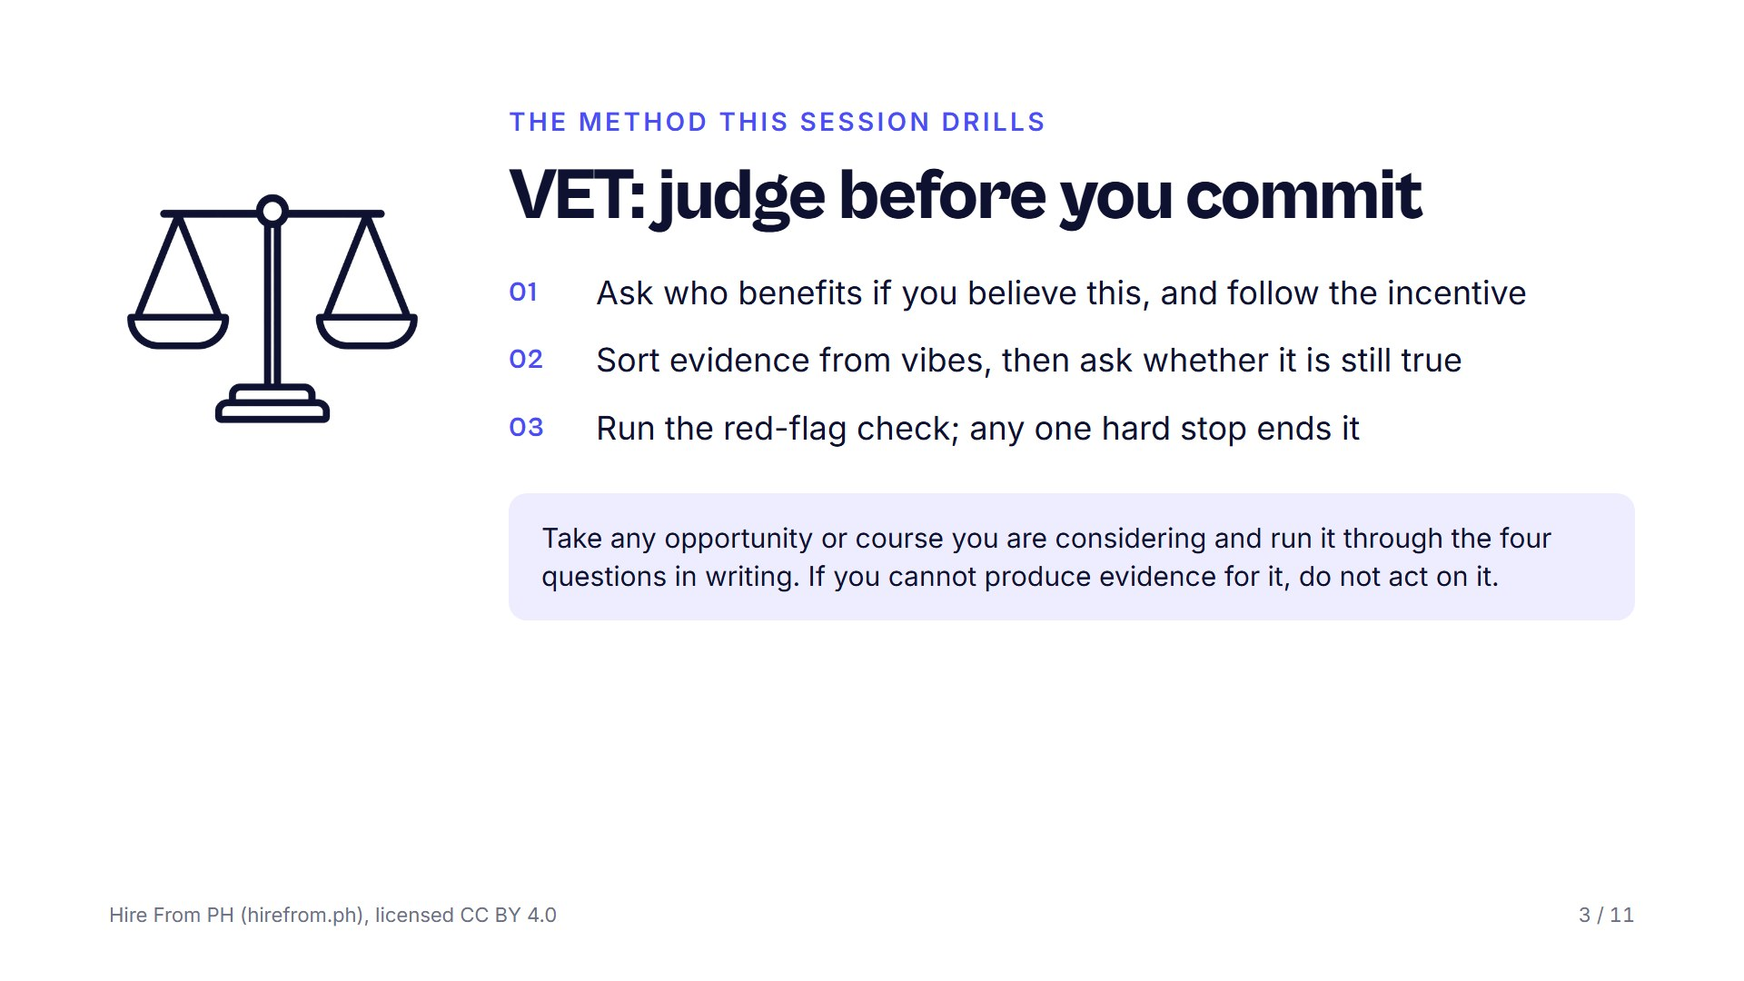
Notes:
Put the VET card up and read the four questions once, in order. Say that confidence is not accuracy and that advice often arrives with an incentive attached; the room is here to check both. The hard stops are upfront fees, guaranteed income, secrecy, urgency, and vagueness about the actual work, but keep the list itself off the screen until the red-flag pass.

Slide 4
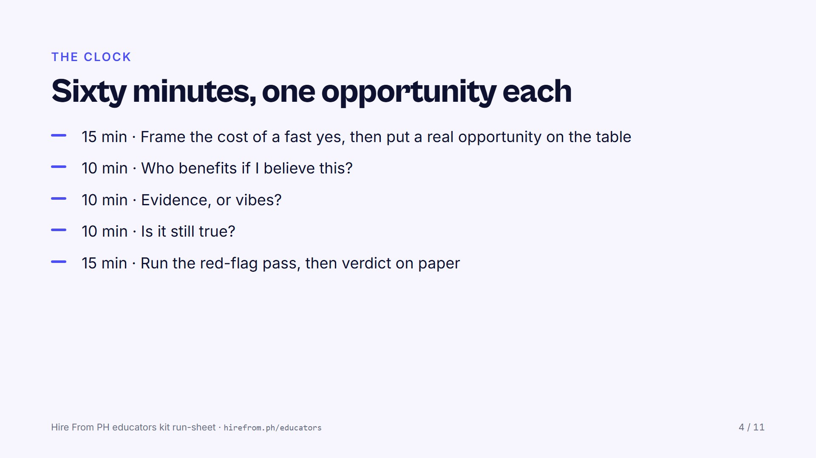
Notes:
Announce each block as it starts. The frame is short and the read-alouds take the rest of the first block; stop anyone who starts defending their post. Keep the red-flag list closed until its block, and protect the last five minutes for the spoken verdict.

Slide 5
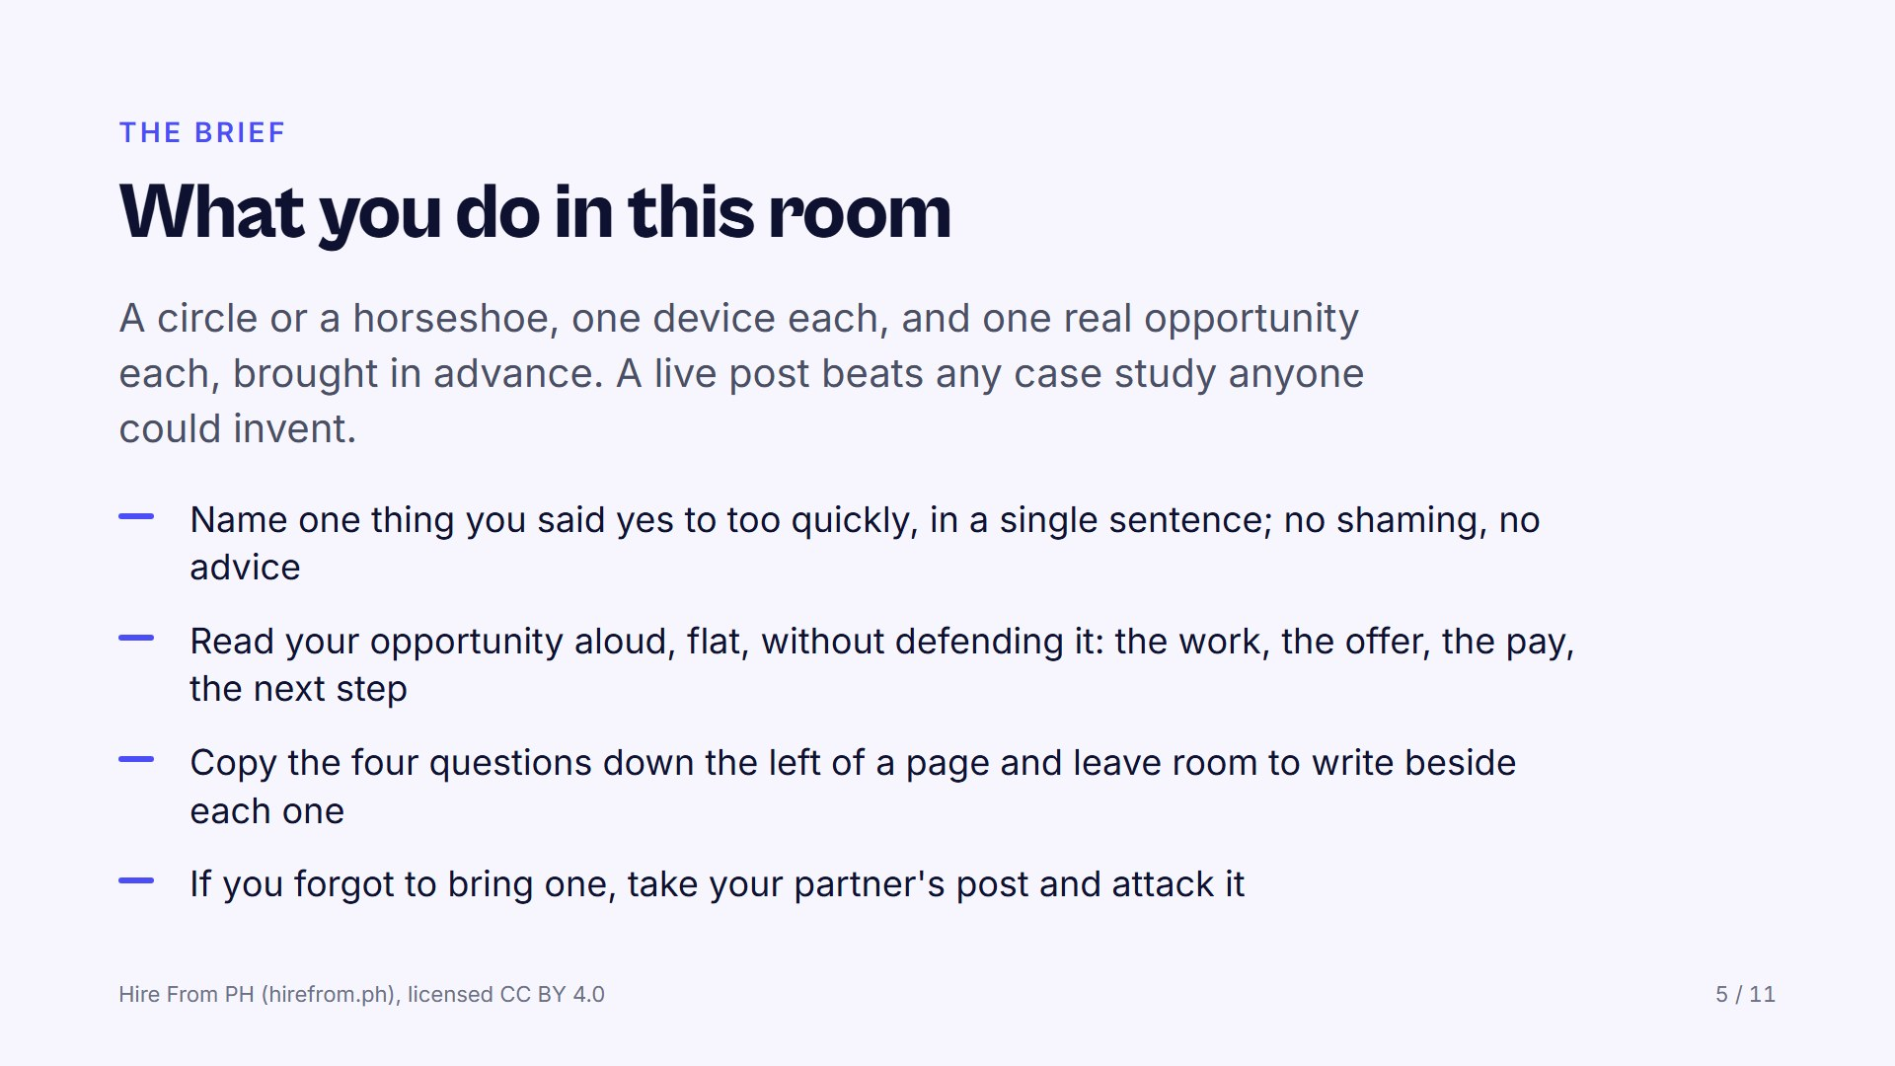
Notes:
Give each person thirty seconds for the read-aloud and hold them to it. Write the four questions on the board as the working sheet while they copy them. Hold two of your own examples in reserve, one that survives all four questions and one that does not, because a room trained only on scams learns to reject everything, which is its own failure.

Slide 6
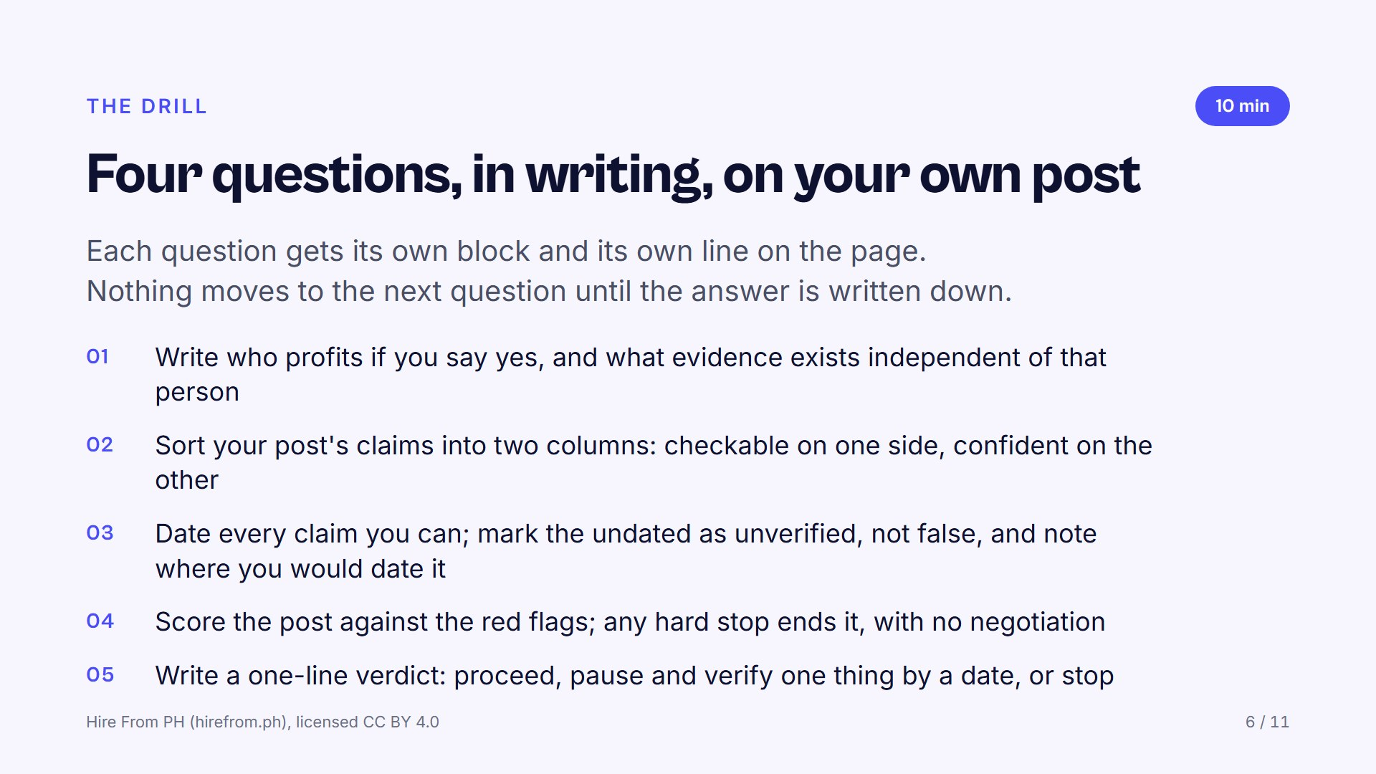
Notes:
Question one: push past the first answer, because every recommendation has a beneficiary, including a warm one from a relative or a churchmate. Question two: take one participant's post and sort its claims aloud with the room before they do their own. Question three: the moment an argument starts, move the room to when this was true; dates end arguments. Watch for anyone negotiating with a hard stop at the end.

Slide 7
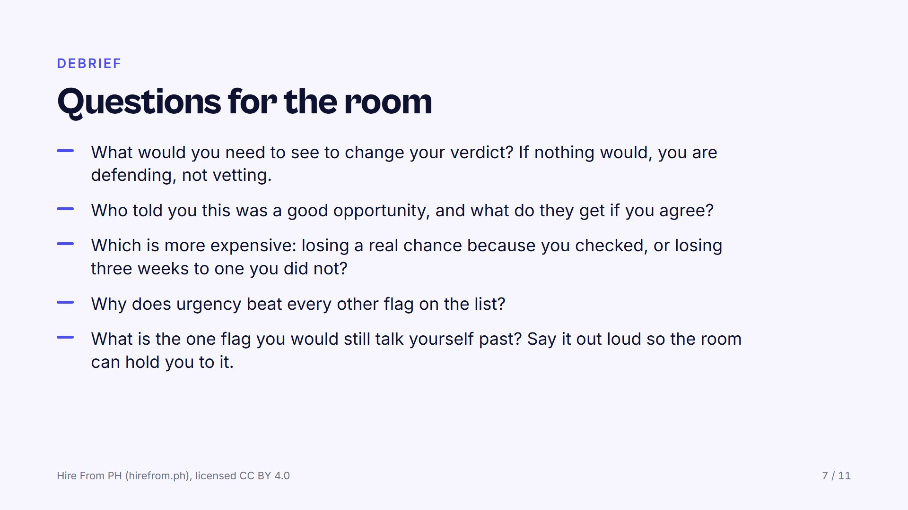
Notes:
If there is time, add the paid skills test: a client offers a short paid test, so how is that different from the unpaid deliverable on the board? Let the last prompt land on each person, because a flag named in front of witnesses is harder to walk past later. Watch for anyone whose verdict was proceed on a post that carried a hard stop.

Slide 8
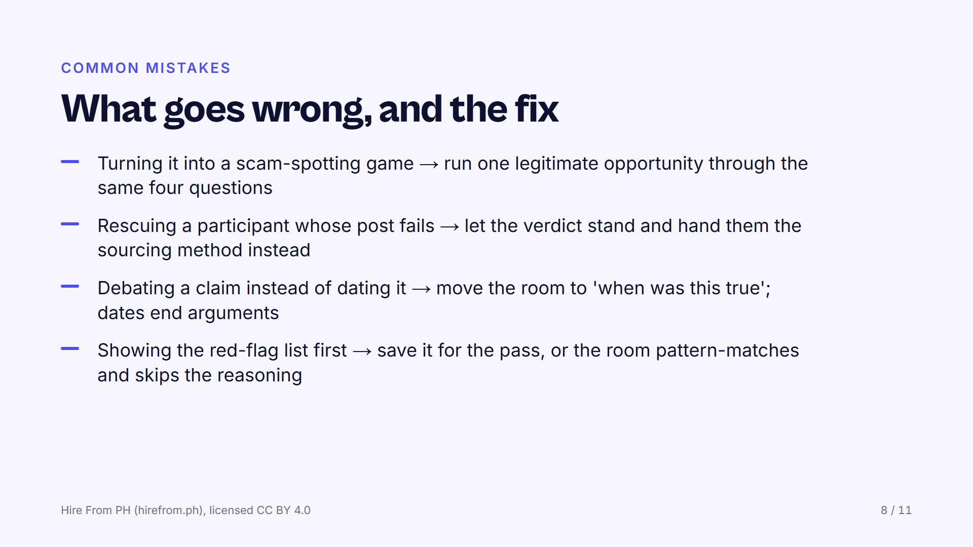
Notes:
A room that only practises on scams learns to say no to everything, and then applies to nothing. Losing one bad post in a room full of witnesses is far cheaper than losing three weeks alone. Opinions extend an argument until the clock runs out; the only part of this that works on flags nobody has listed yet is the reasoning, so do not let the list replace it.

Slide 9
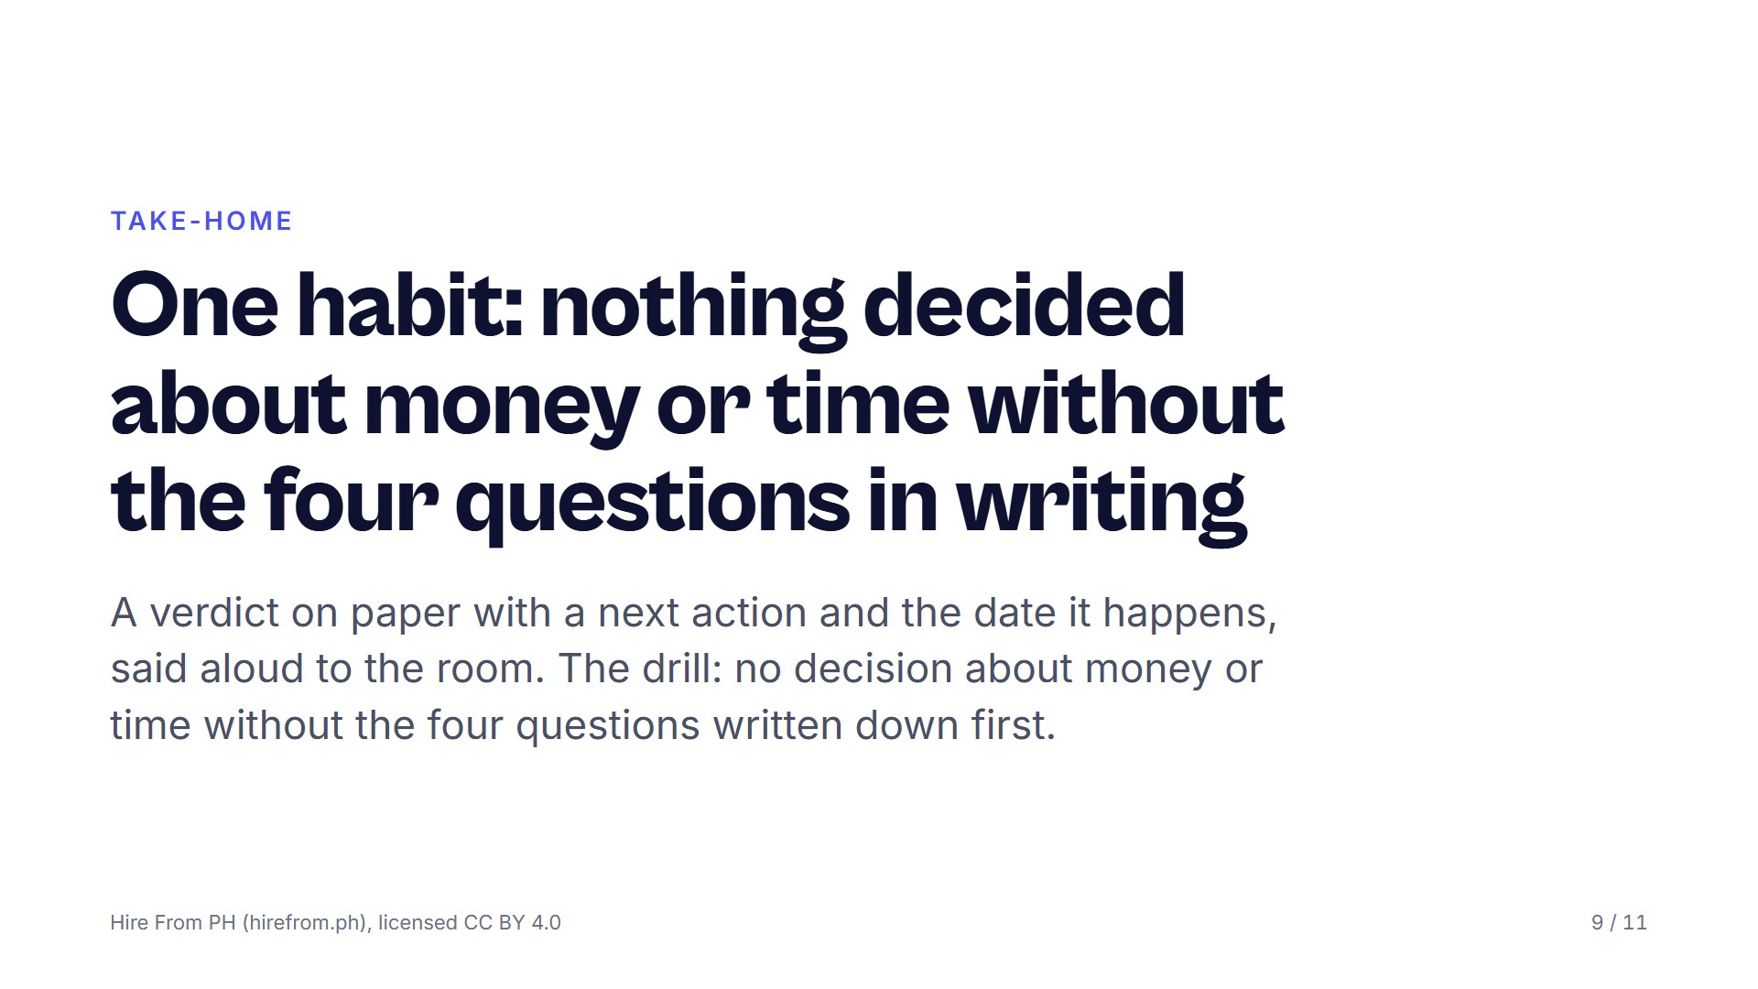
Notes:
Make each person commit aloud, because a spoken verdict is harder to talk yourself out of. Say the drill out loud and have them write it under their verdict. Name when the group meets again; a drill without a next date quietly expires.

Slide 10
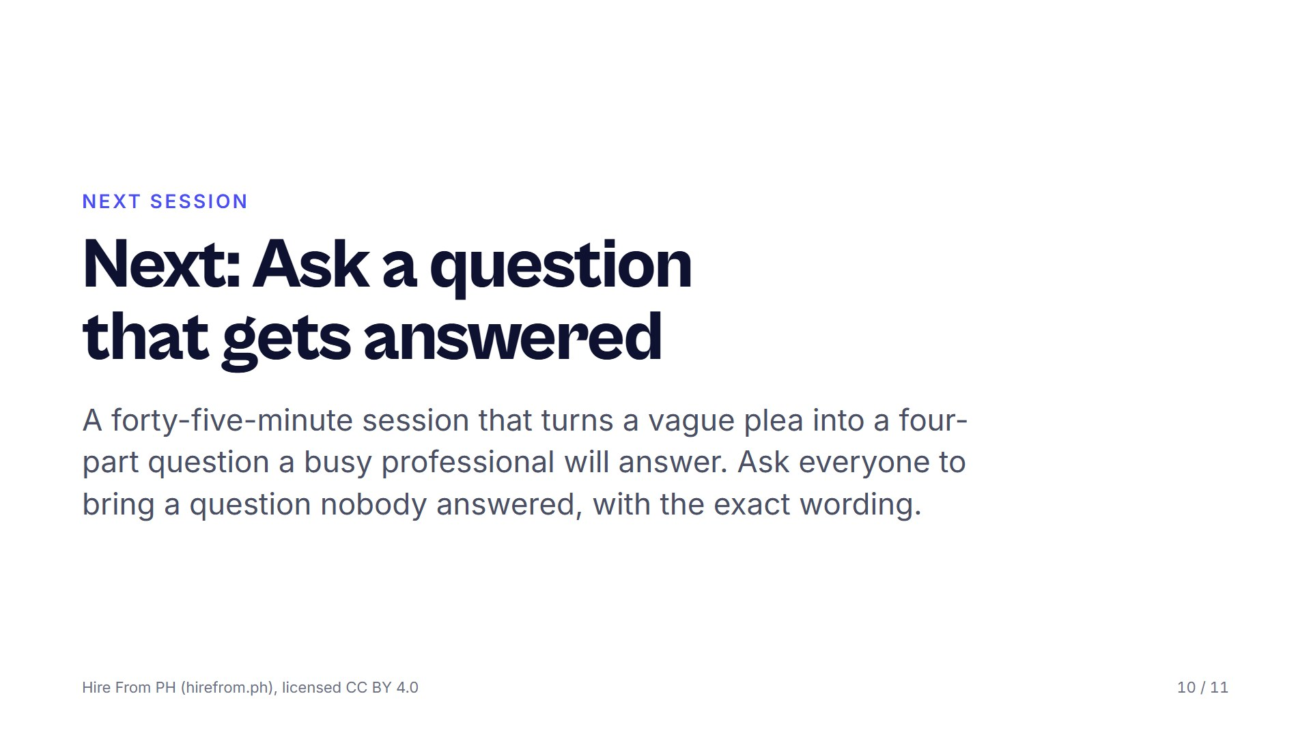
Notes:
Each session asks a different thing of the room: this one needed honesty, ASK needs quiet, DECONSTRUCT needs argument. Choose the one your group can carry next. Ask for the unanswered question days ahead, screenshots welcome, because the exact wording is the material.

Slide 11
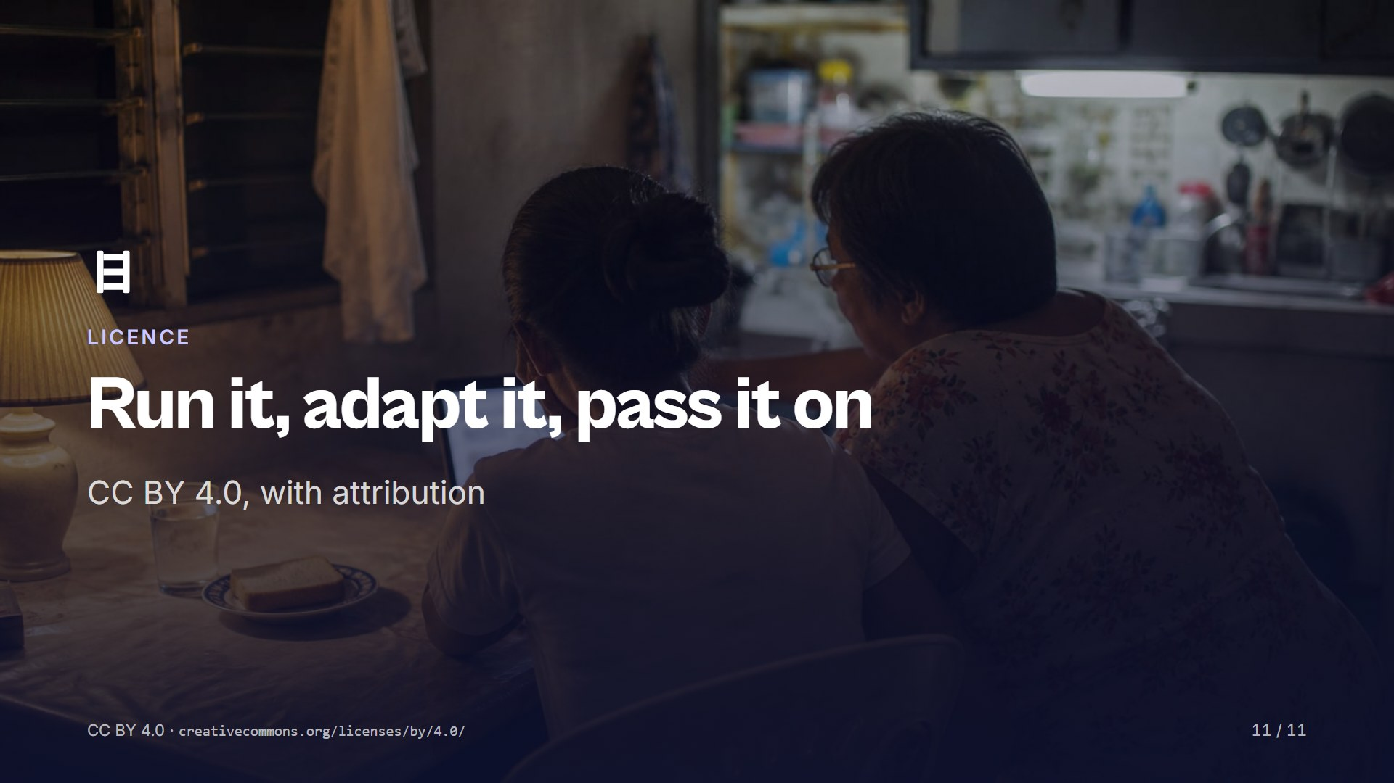
Notes:
Share and adapt this session, including inside training you are paid to run, as long as you credit Hire From PH (hirefrom.ph) and say what you changed. Run it once as written before you change it, then tell the next facilitator what you improved. Nothing here needs our permission or our presence.

