Slide 1
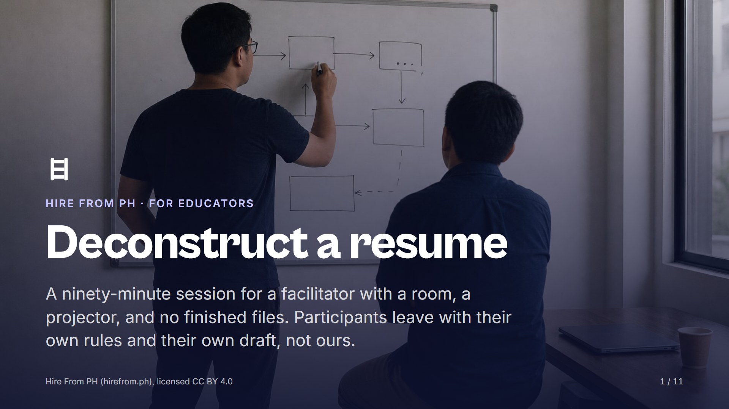
Notes:
Open on this slide while the room settles, then say the standard out loud before anything else: we hand out no finished files here. Tell them the session ends on a blank page so they know where it is going. Watch for anyone waiting for a template to appear; it never does, and saying so now saves you from saying it six times later.

Slide 2
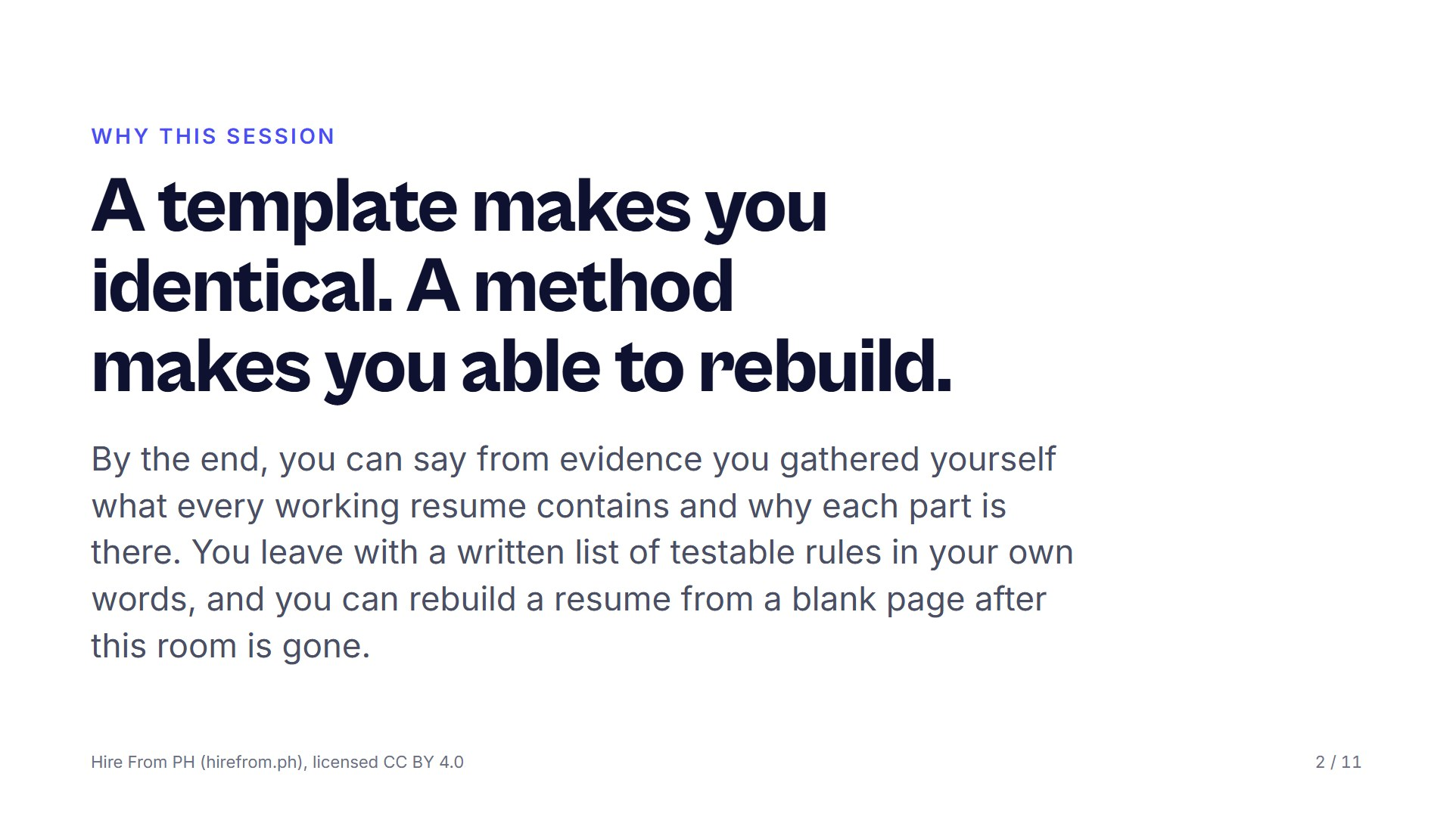
Notes:
Read the three objectives plainly; they are the contract for the next ninety minutes. Ask who has downloaded a resume template and how far it got them, take two honest answers, and correct neither. Ask what a downloaded template stops doing the moment the job is slightly different, and let the room answer.

Slide 3
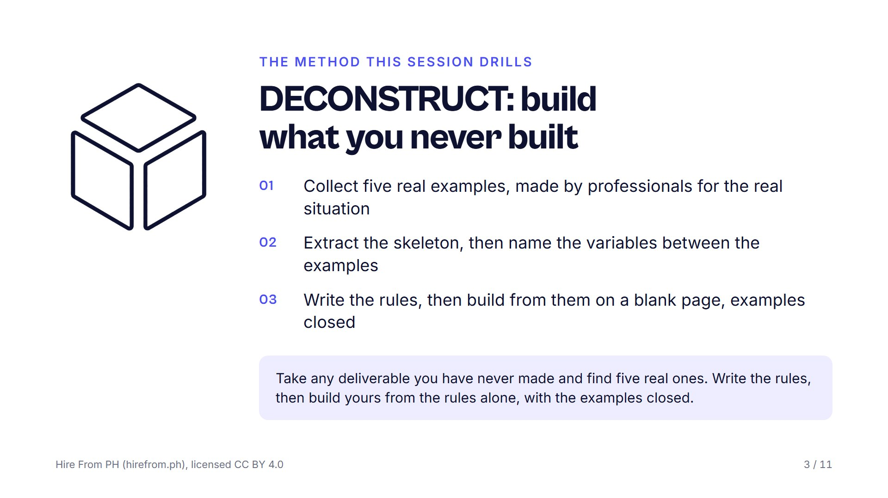
Notes:
Put the DECONSTRUCT card on the screen and read its steps once, slowly. Say that the skeleton is what every example shares and the variables are the judgment calls the writer made for a reason. Ask the room to write the steps at the top of a blank page; that page is their rule sheet for the rest of the session.

Slide 4
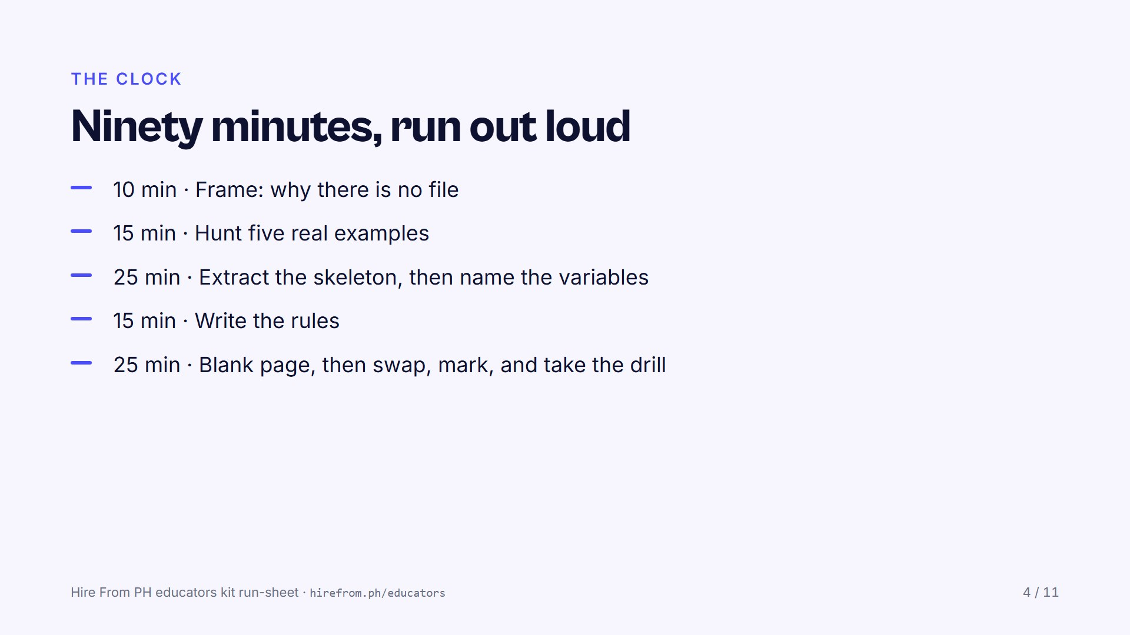
Notes:
Keep the printed run-sheet face up beside you and announce each block as it starts; saying the clock aloud does more than any slide. The last two blocks are the session, so hold the hunt to its time even when a pair has only three examples. The skeleton and the variables share the wall; the build and the swap share the blank paper.

Slide 5
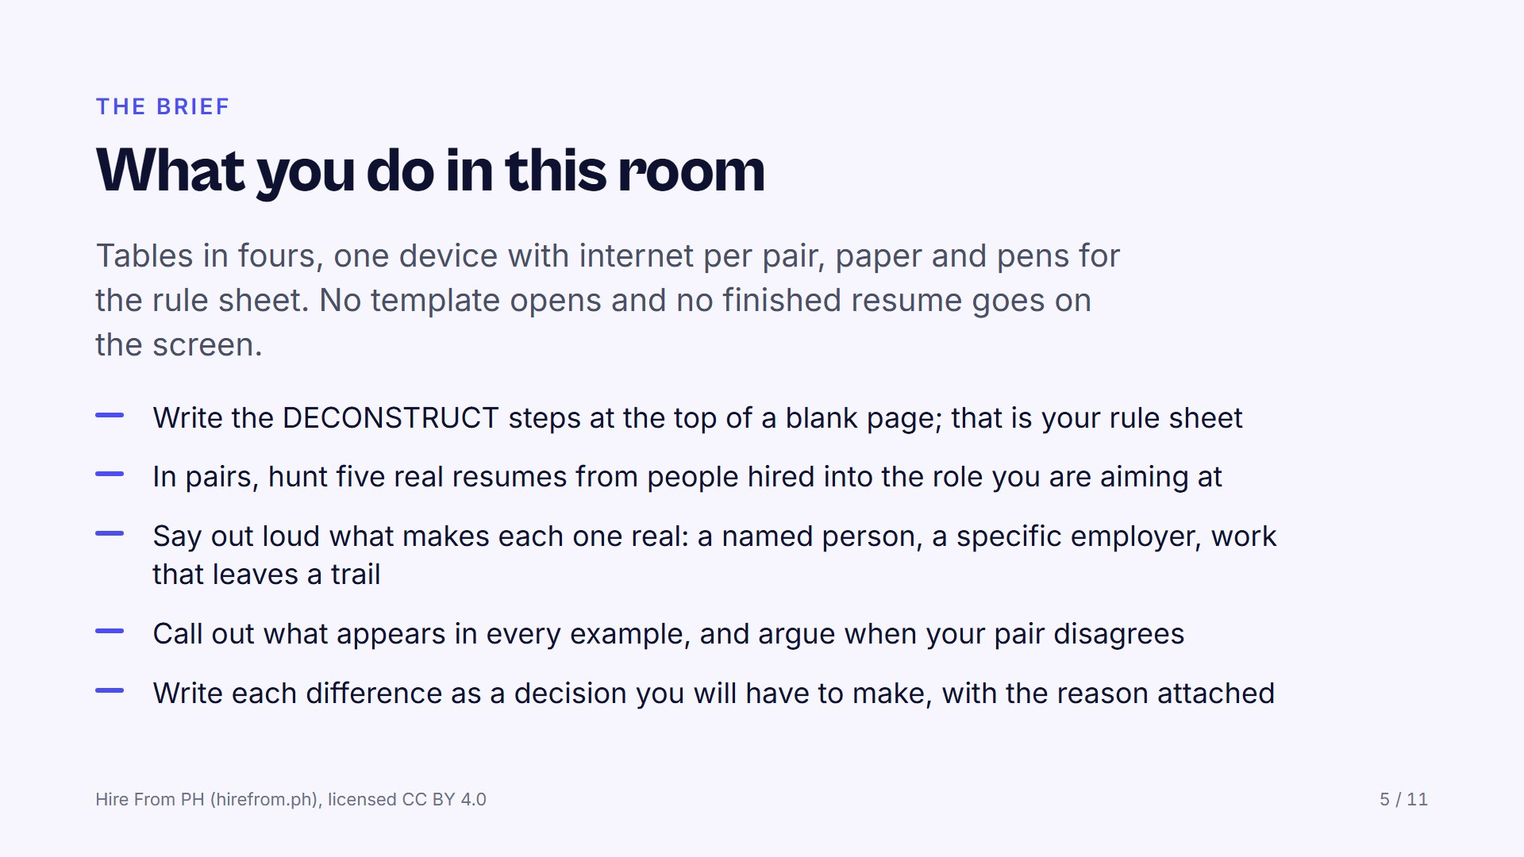
Notes:
Set the hunt plainly: real documents, not template galleries, not builder exports. Read the search tactics from the resume lab, then circulate and reject anything that came from a template site. If the line dies, have each pair write down from memory the last three resumes they have seen and compare those; the skeleton still appears.

Slide 6
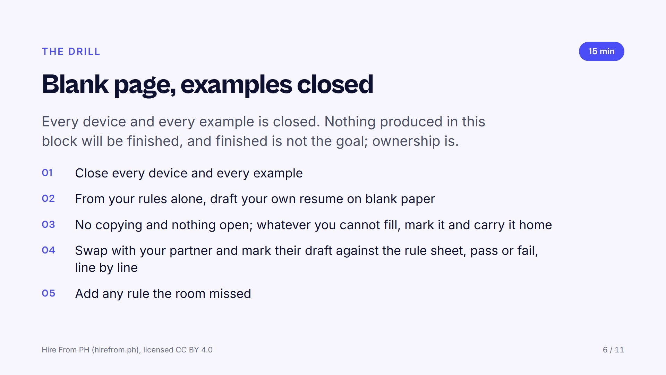
Notes:
Hand out blank paper, keep the clock visible, then stay quiet; resist filling the silence. If time runs short, cut the critique and never the build, because the build is the session and everything before it was preparation. Only after the swap put the resume lab's self-critique list on the screen and ask two questions: what did your rules catch that ours did not, and what did ours catch that yours missed?

Slide 7
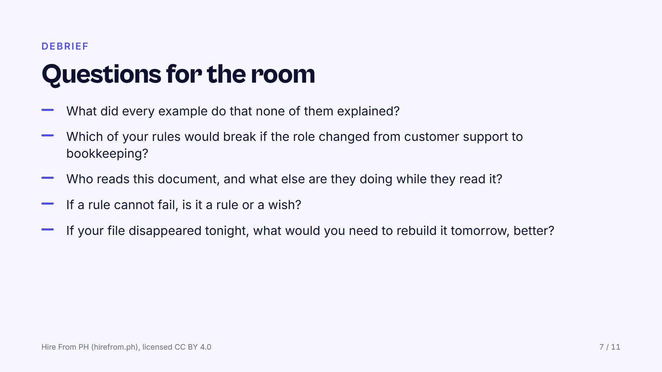
Notes:
Pick two or three of these, not all of them, and let the silence after each one run longer than feels comfortable. On the rule that breaks when the role changes, push for the follow-up: is that a bad rule, or a rule that needs a condition attached? Watch for the pair who copied without noticing, and ask what that tells them about how one template spreads through a whole batch.

Slide 8
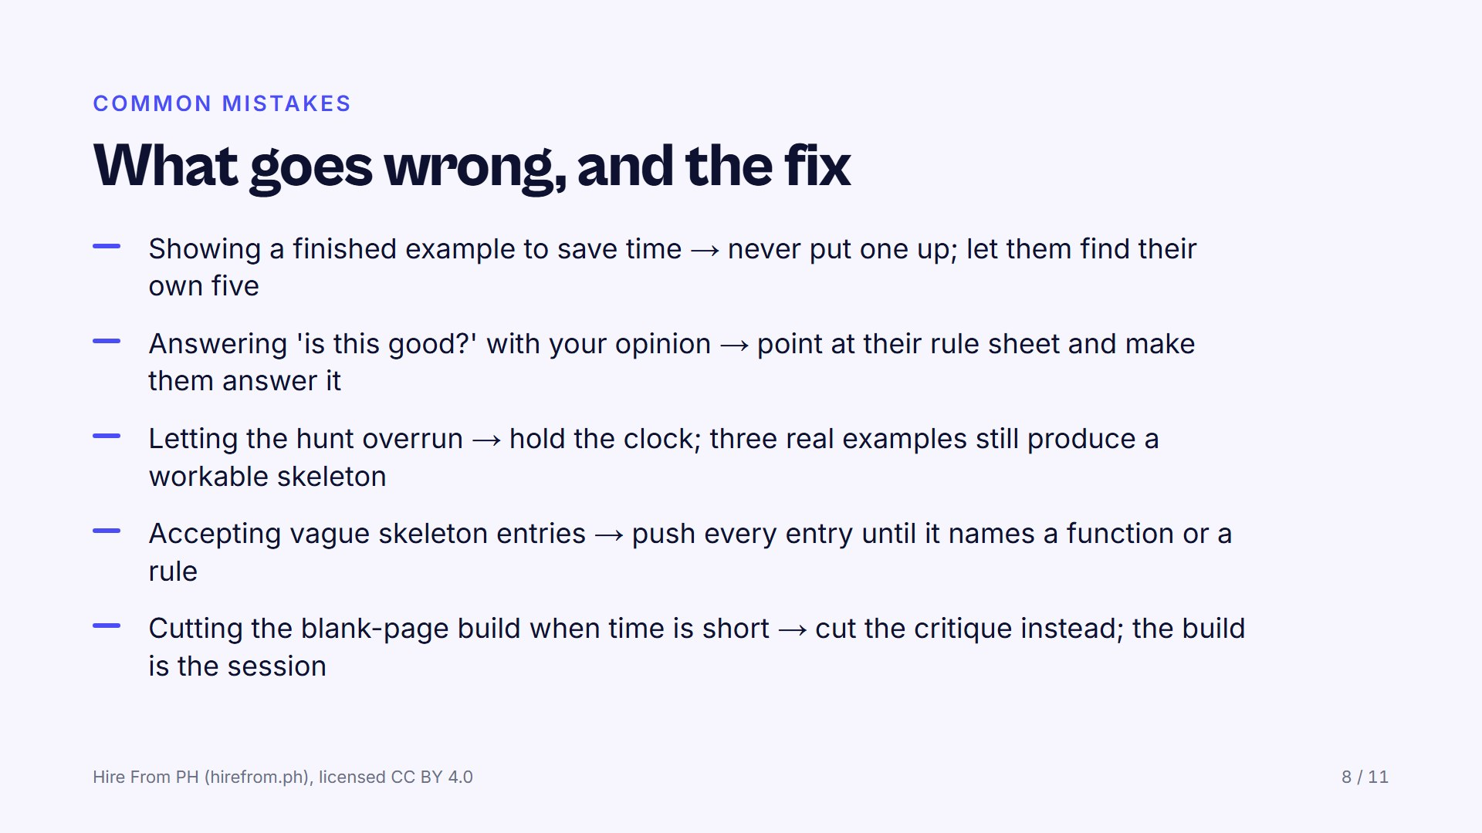
Notes:
Read the first one twice, because it is the one every facilitator is tempted by; the room stops extracting and starts transcribing. Your taste does not travel out of the room, but their rules do. Agreement on a vague entry feels like progress and teaches nothing, so keep refusing entries until they can fail.

Slide 9
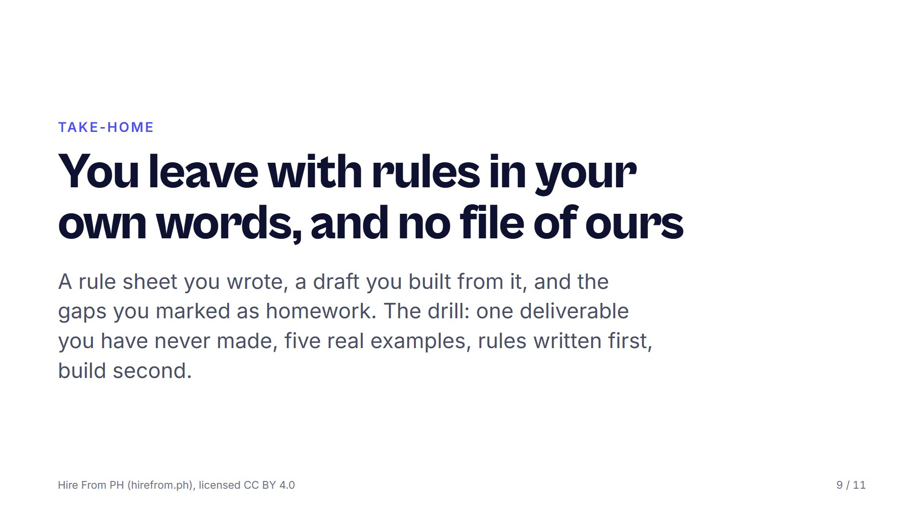
Notes:
Say the drill out loud and have them write it on the rule sheet before anyone stands up. Name when the group meets again; a drill without a next date quietly expires. Remind them that the marked gaps are the homework, not a failure.

Slide 10
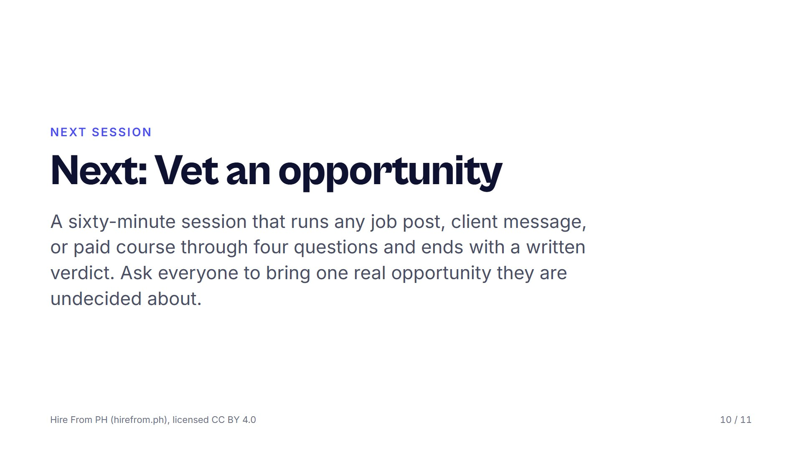
Notes:
Each session asks a different thing of the room: this one needed argument, VET needs honesty, ASK needs quiet. Choose the one your group can carry next. Send the bring-one-opportunity request days ahead, then remind them the morning of.

Slide 11
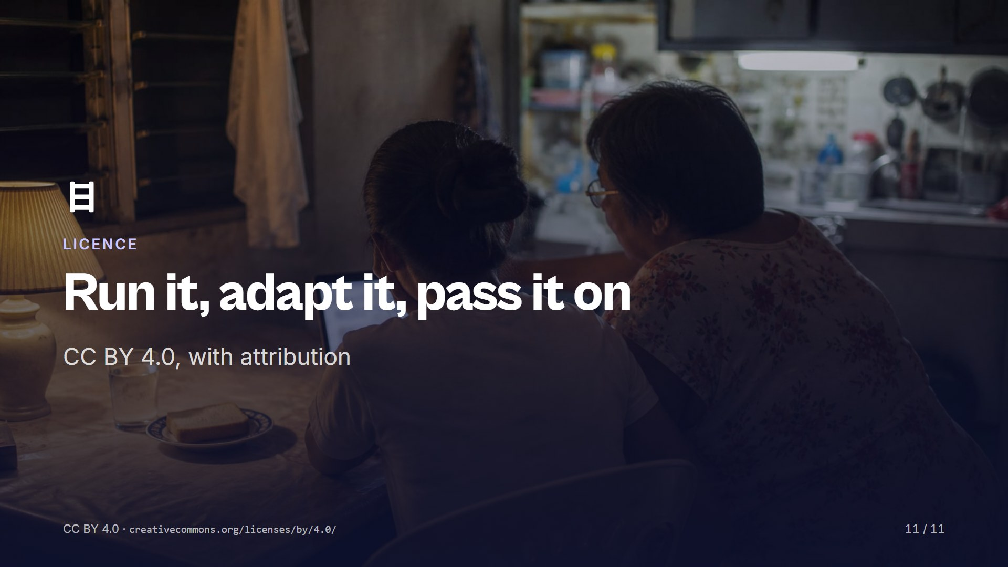
Notes:
Share and adapt this session, including inside training you are paid to run, as long as you credit Hire From PH (hirefrom.ph) and say what you changed. Run it once as written before you change it, then tell the next facilitator what you improved. Nothing here needs our permission or our presence.

