Slide 1
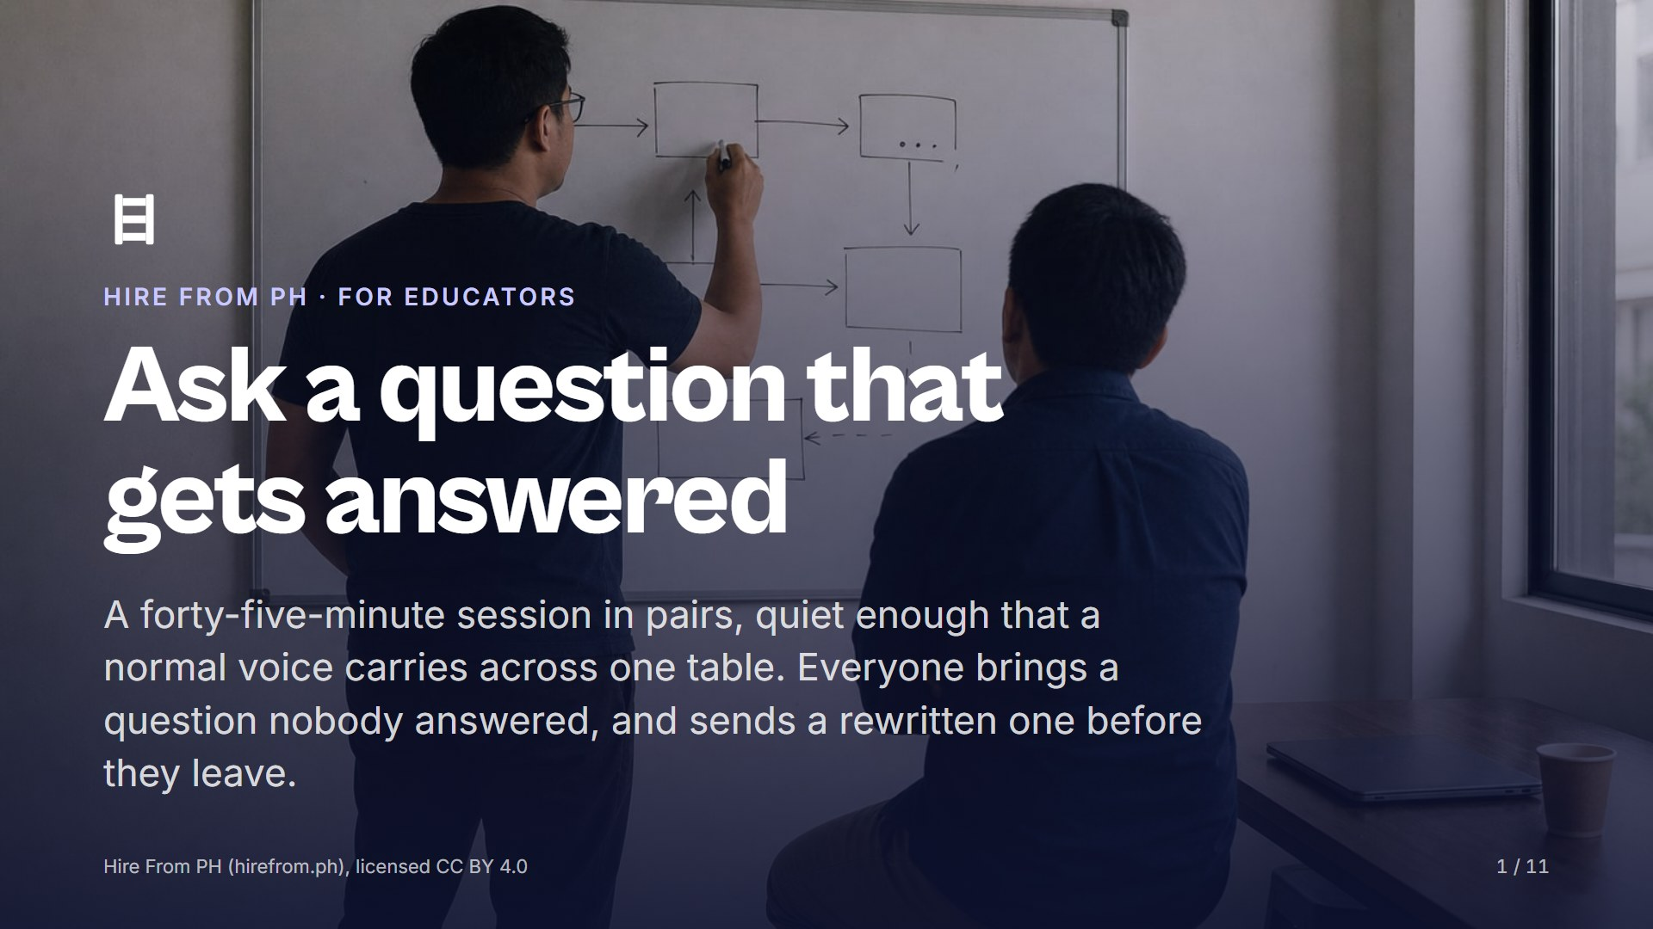
Notes:
Open on this slide while pairs settle facing each other. This session runs on reading aloud, so keep the room quiet and the tables close. Check that everyone has their unanswered question, screenshot or written, because the exact wording is the material of the next forty-five minutes.

Slide 2
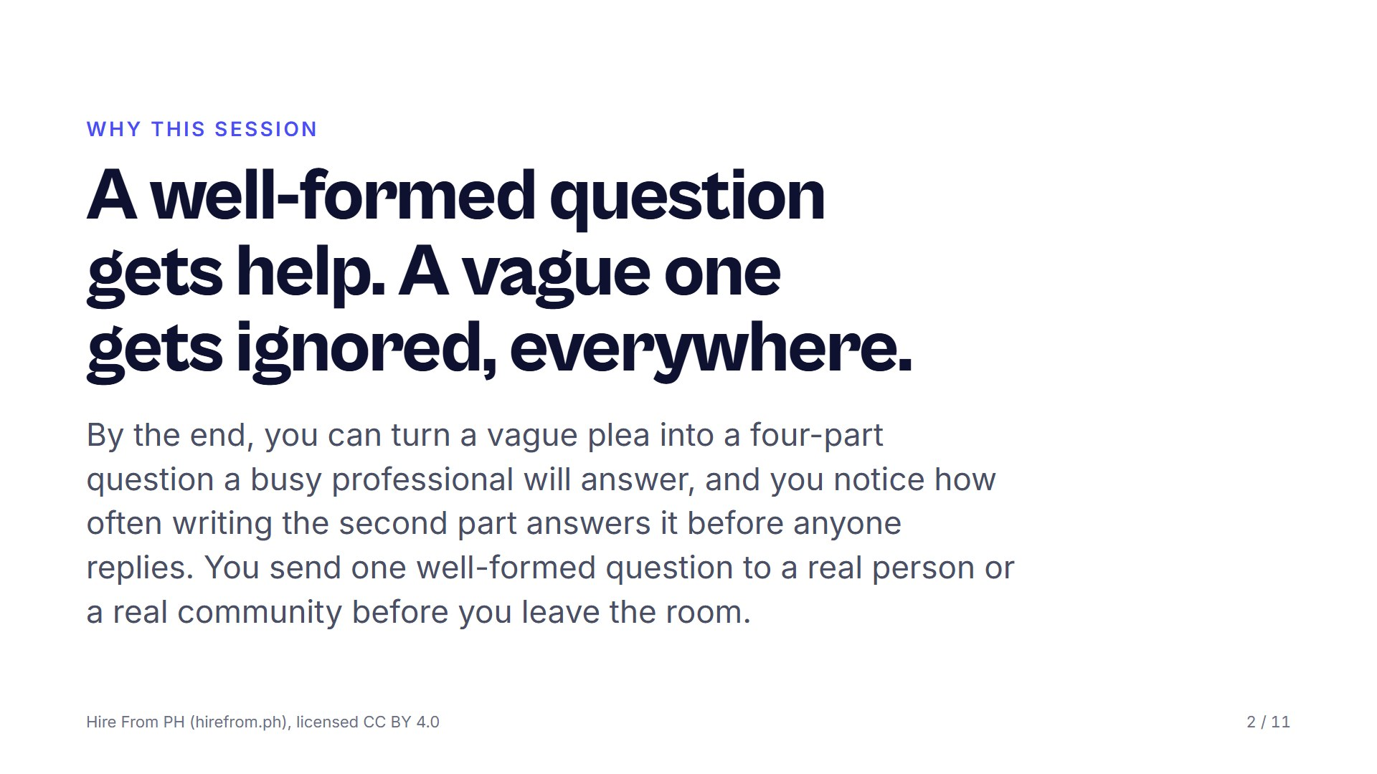
Notes:
Read two questions aloud: 'hi po, pa help, di gumagana' and a four-part one. Ask which they would answer with four minutes left and a full inbox; nobody needs convincing after that. Say that this is not a session about politeness but about respecting the reader's time, because politeness without structure still gets scrolled past.

Slide 3
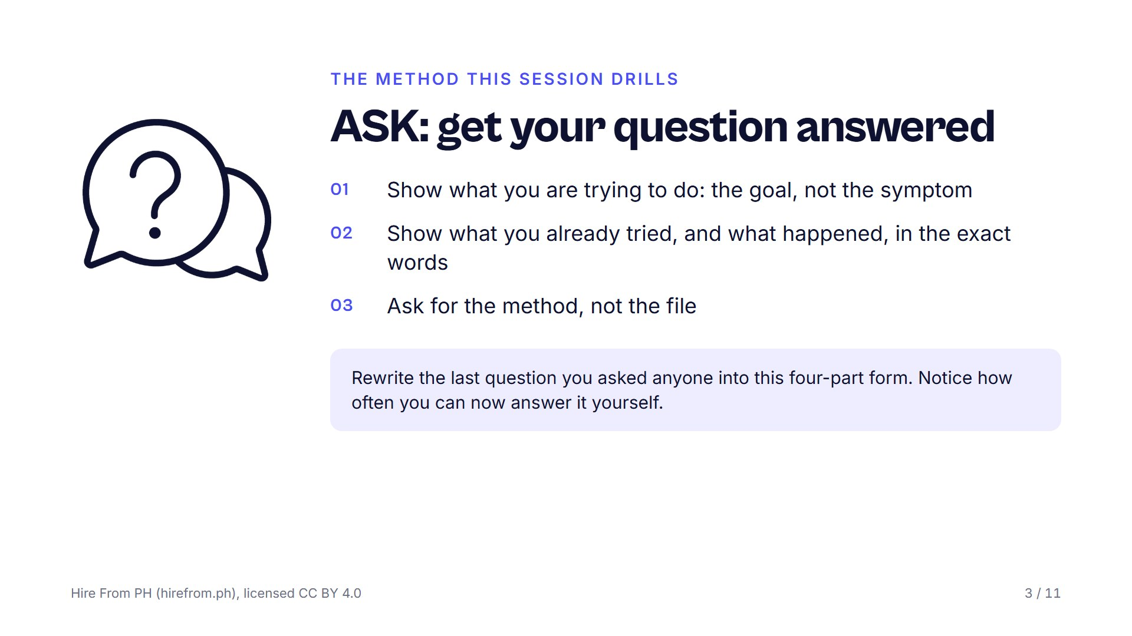
Notes:
Put the ASK card on the screen and have the room write the four parts down the page: goal, tried, happened, ask. Say that showing what you tried proves you respect the other person's time and removes the first five things they would have suggested. Keep the UNSTICK card beside it for the close, since the two methods only work as a pair.

Slide 4
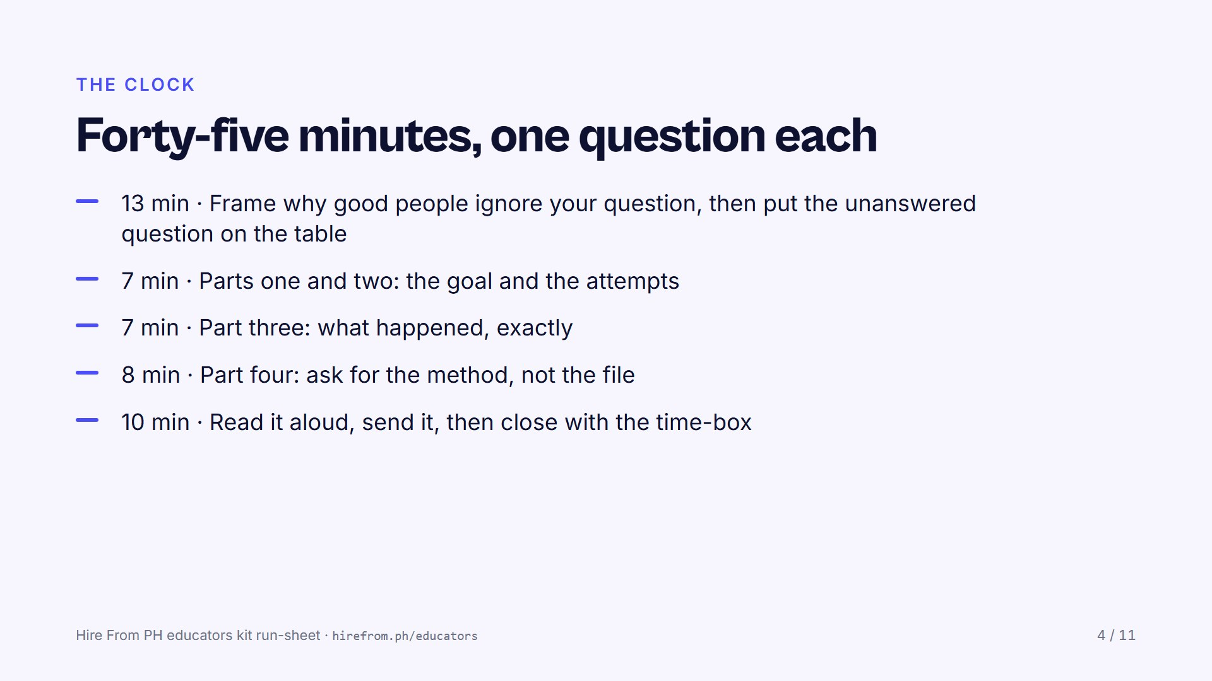
Notes:
Announce each block as it starts; the parts are short and the room will want to linger on grammar, so keep moving. Protect the last block above everything else. A rewritten question that stays in a notebook has changed nothing about the participant's week.

Slide 5
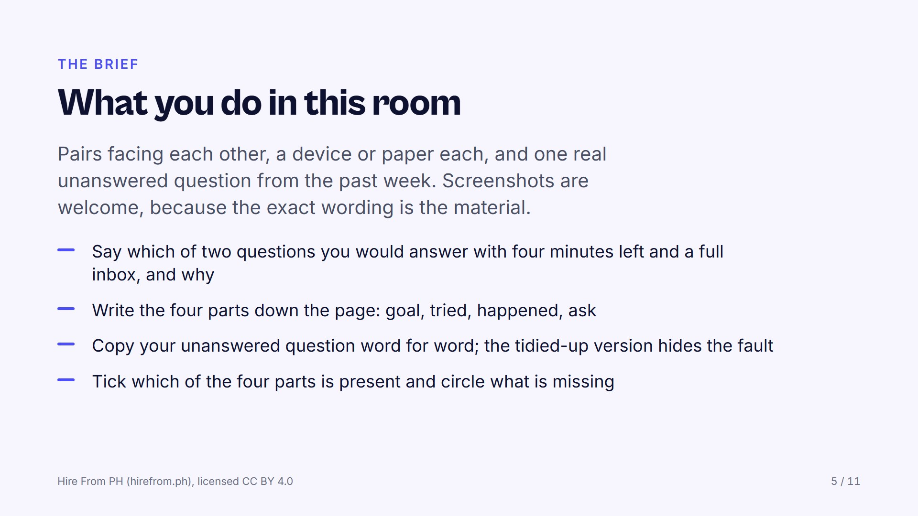
Notes:
Insist on word for word when they copy the original question, because the polish hides the fault. Most pages end up with one tick and three circles, and that is the point, not a failure. Watch for anyone who starts rewriting before they have ticked and circled; the diagnosis comes first.

Slide 6
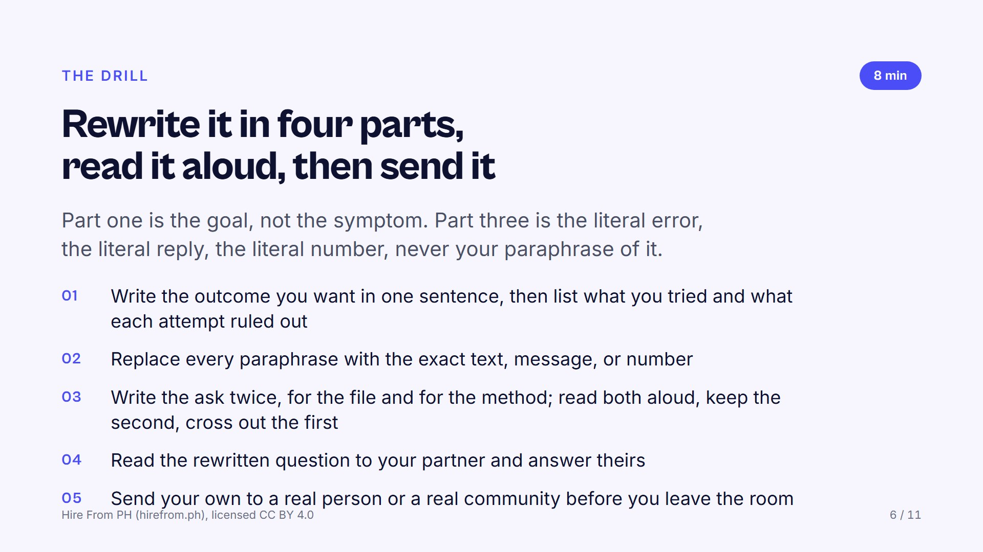
Notes:
Refuse 'I tried everything'; it tells the reader nothing and costs them time. Take one paraphrase from the room and ask for the exact words in front of everyone, so the gap between the two is visible to all of them. At the read-aloud, ask the listener one thing: could you answer this? Then ask the writer whether they can now answer it themselves, and count the hands; that count is the lesson of the session.

Slide 7
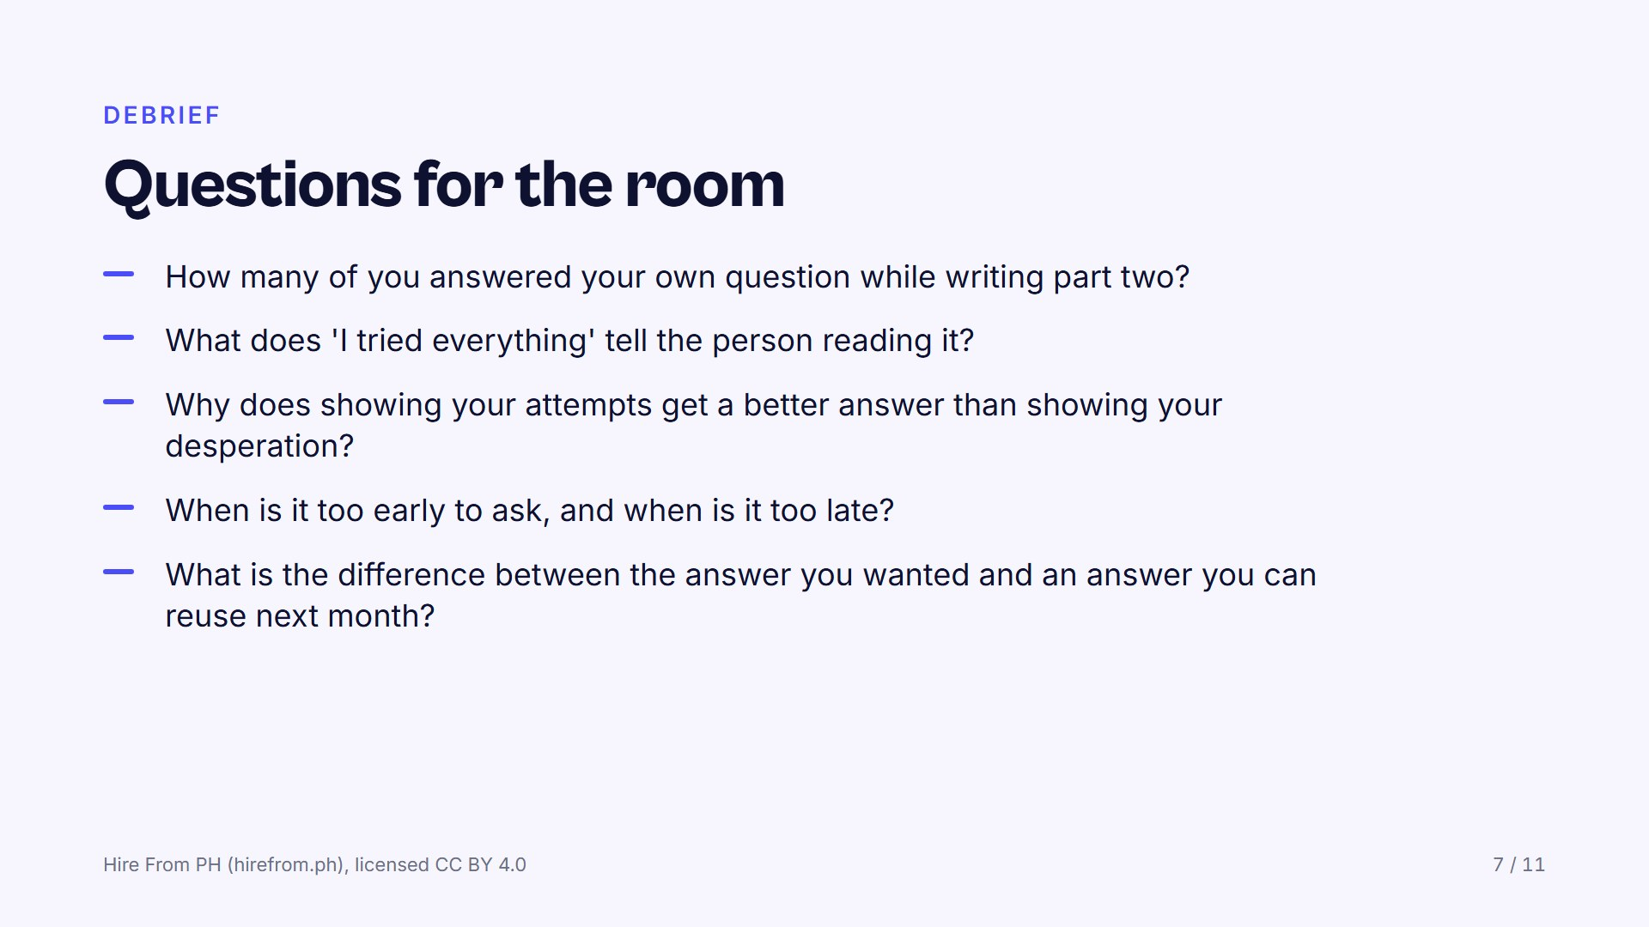
Notes:
Start with the first prompt and count the hands again, because the number who answered themselves is the argument for the whole method. On the last prompt, push towards asking for the method: the file ends the day it goes out of date, and the method is something they keep. Watch for the person whose rewritten question still asks for a file, and ask them to read both versions aloud.

Slide 8
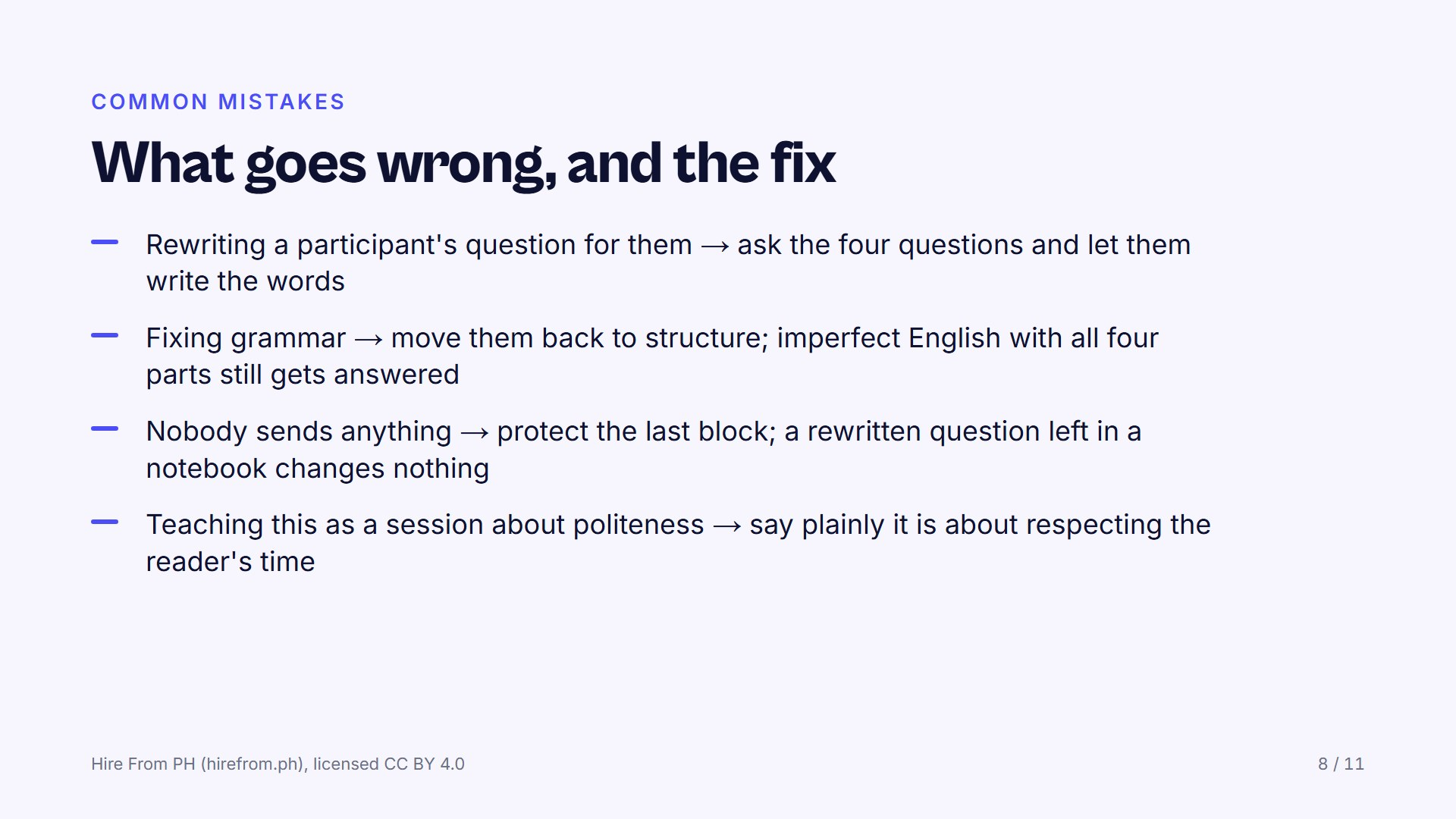
Notes:
A question you wrote is a question they cannot reproduce next week without you, so keep your hands off their words. A polished vague question does not get answered; a rough one with all four parts does. If the clock is against you, cut the debrief before you cut the sending.

Slide 9
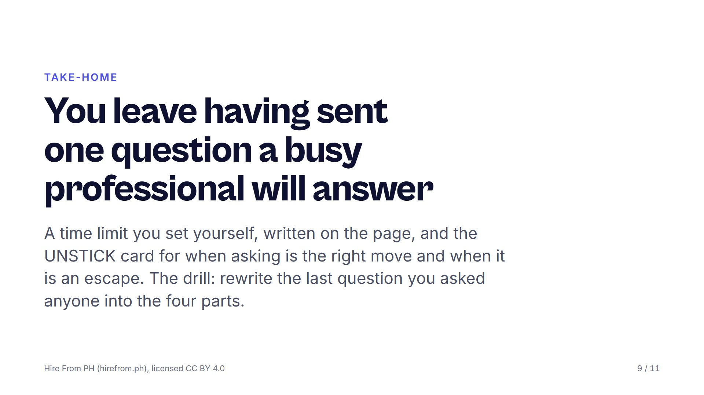
Notes:
Name the rule that stops grinding: a hard limit, then ask. Point at the UNSTICK card so they know when asking is the right move and when it is an escape. Say the drill out loud, have them write it on the page, and name when the group meets again.

Slide 10
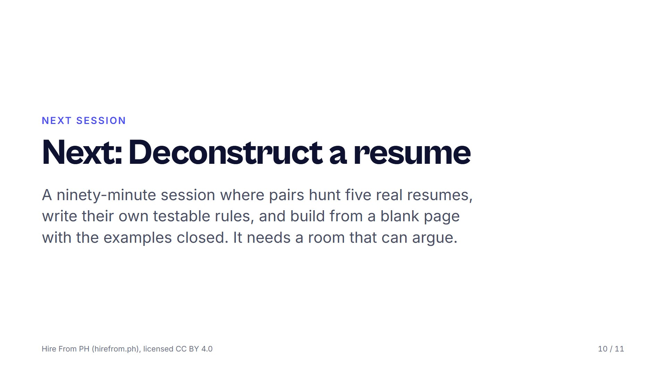
Notes:
Each session asks a different thing of the room: this one needed quiet, DECONSTRUCT needs argument, VET needs honesty. Choose the one your group can carry next. Book the room with tables in fours and test the connection the day before, not on the hour.

Slide 11
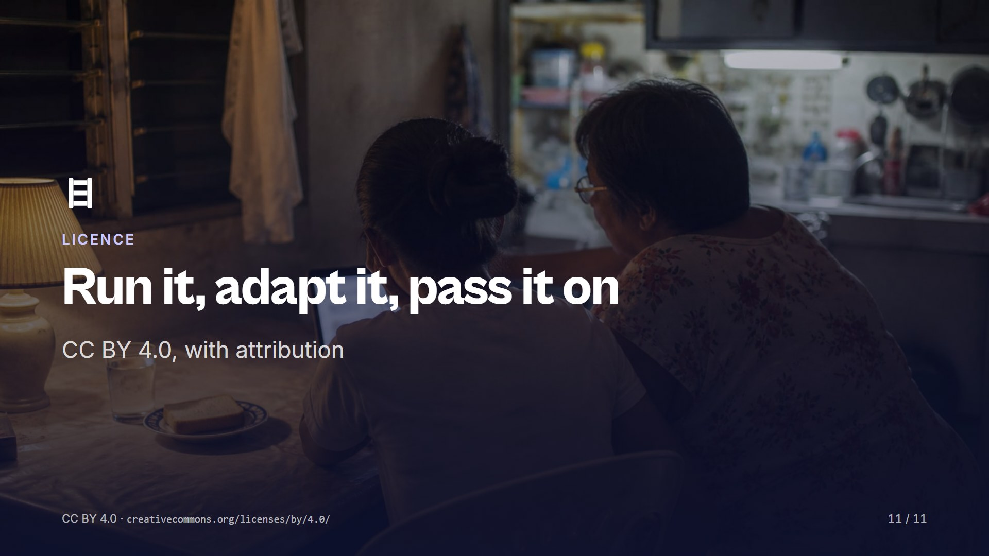
Notes:
Share and adapt this session, including inside training you are paid to run, as long as you credit Hire From PH (hirefrom.ph) and say what you changed. Run it once as written before you change it, then tell the next facilitator what you improved. Nothing here needs our permission or our presence.

