Slide 1
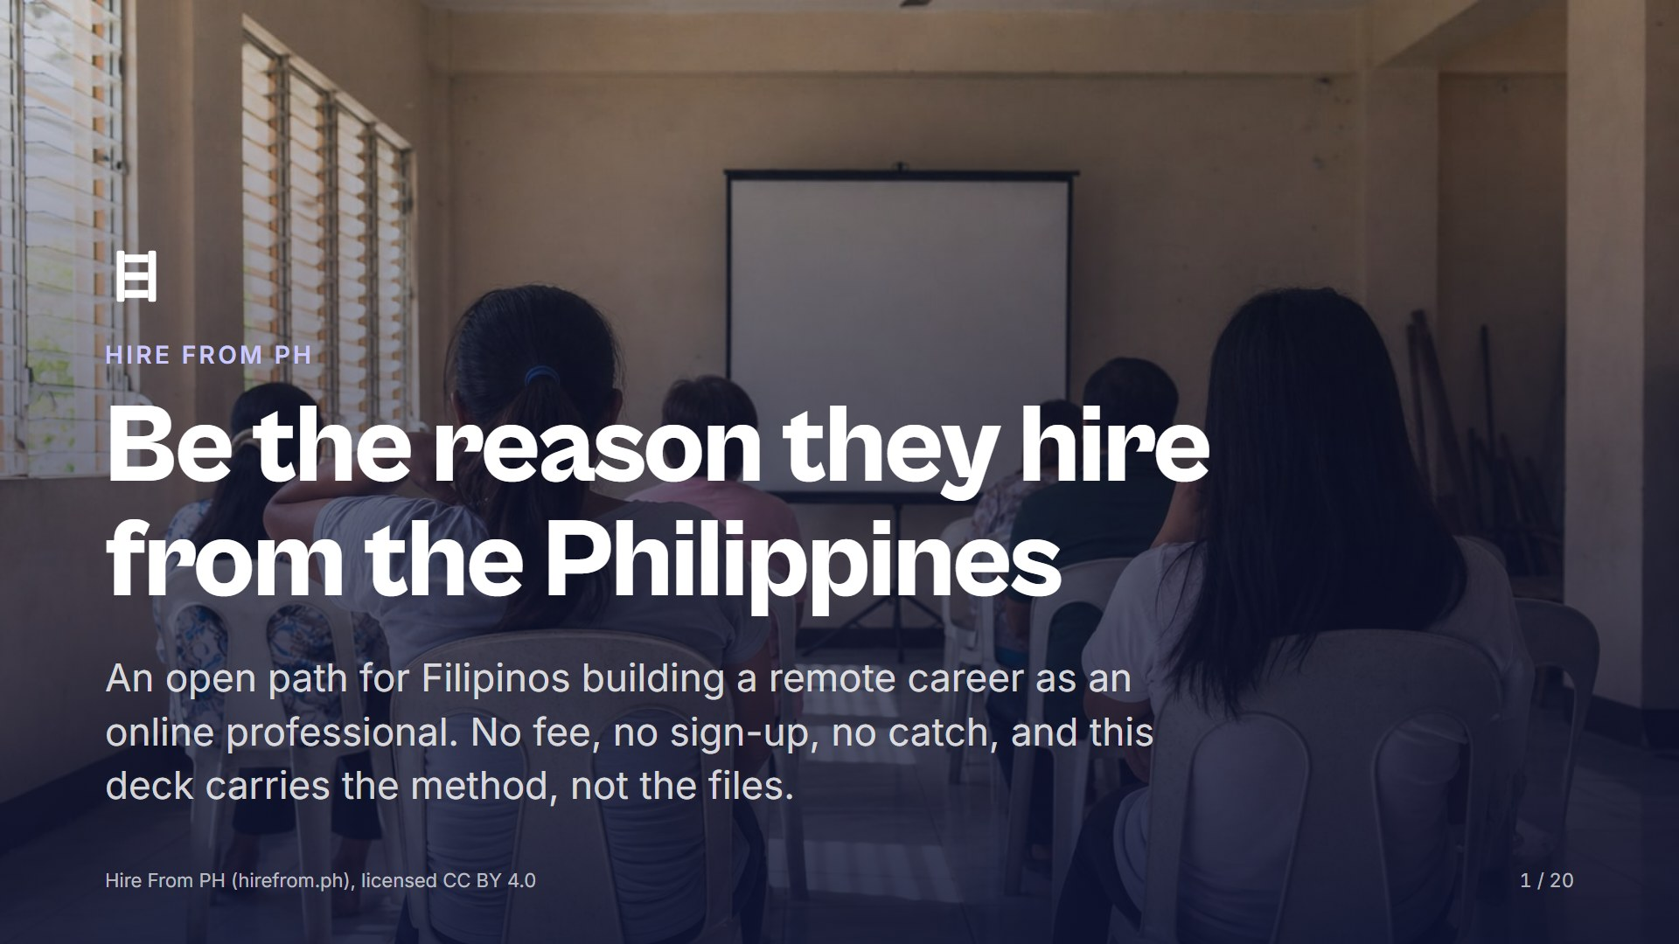
Notes:
Say who you are and why you are running this, then say the one thing the room needs to hear first: nobody here will be handed a finished file today. Ask how many people have downloaded a template and how far it got them. Take two honest answers and correct neither.

Slide 2
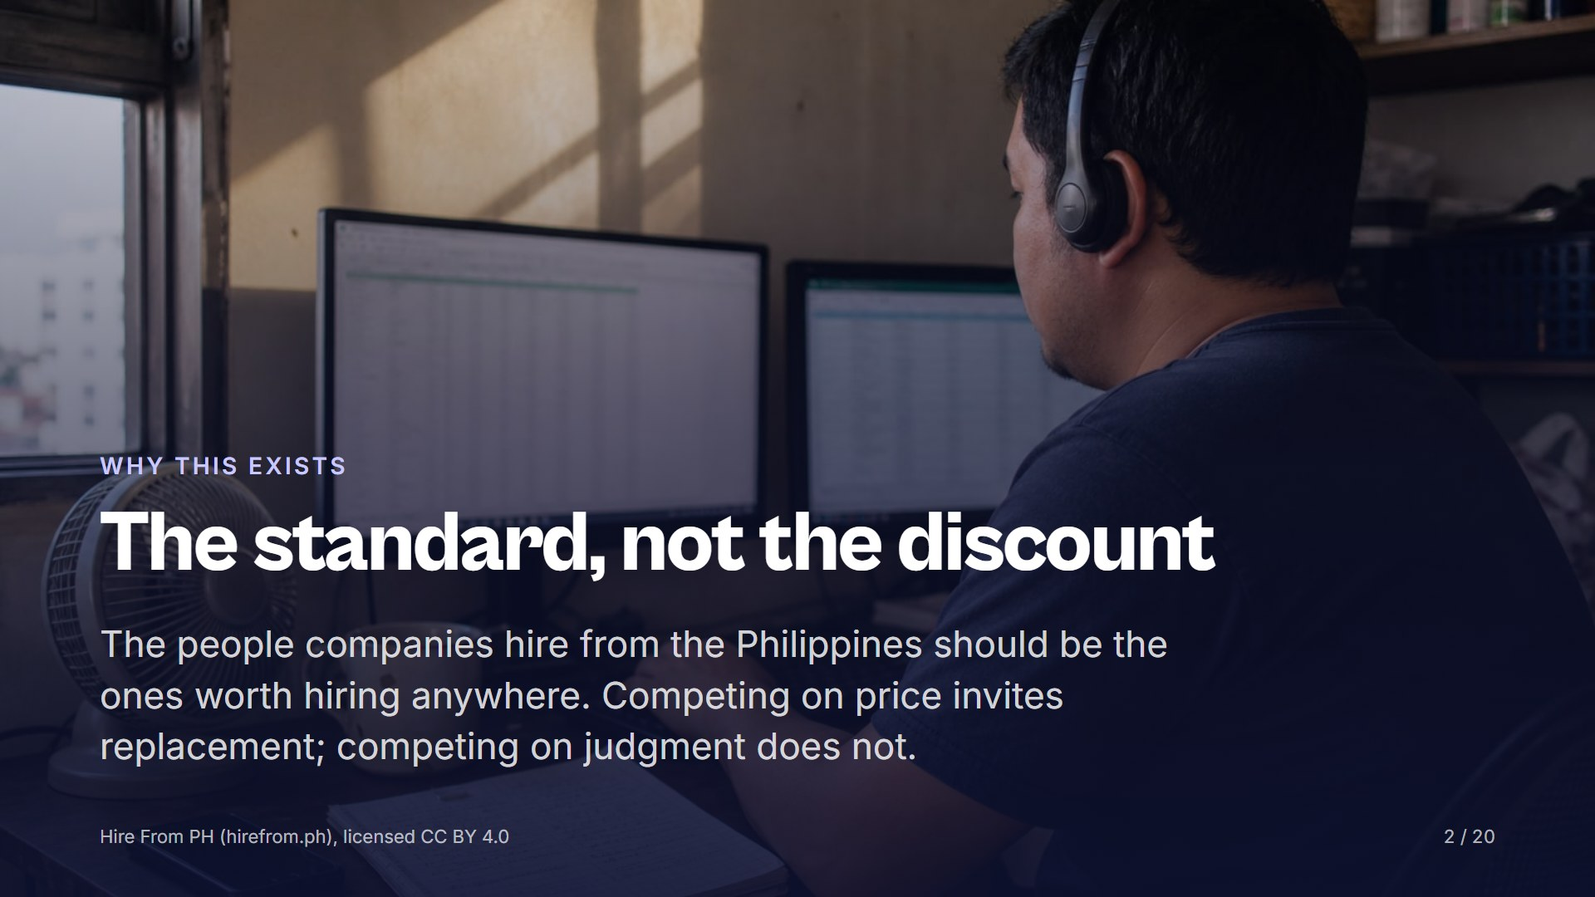
Notes:
Say it plainly: a worker hired because they are cheap is replaced the moment someone cheaper appears. A worker hired for judgment is kept and referred. Ask the room which one they have been so far, and which one they want to be by the end of the year. Everything after this slide builds toward the second answer.

Slide 3
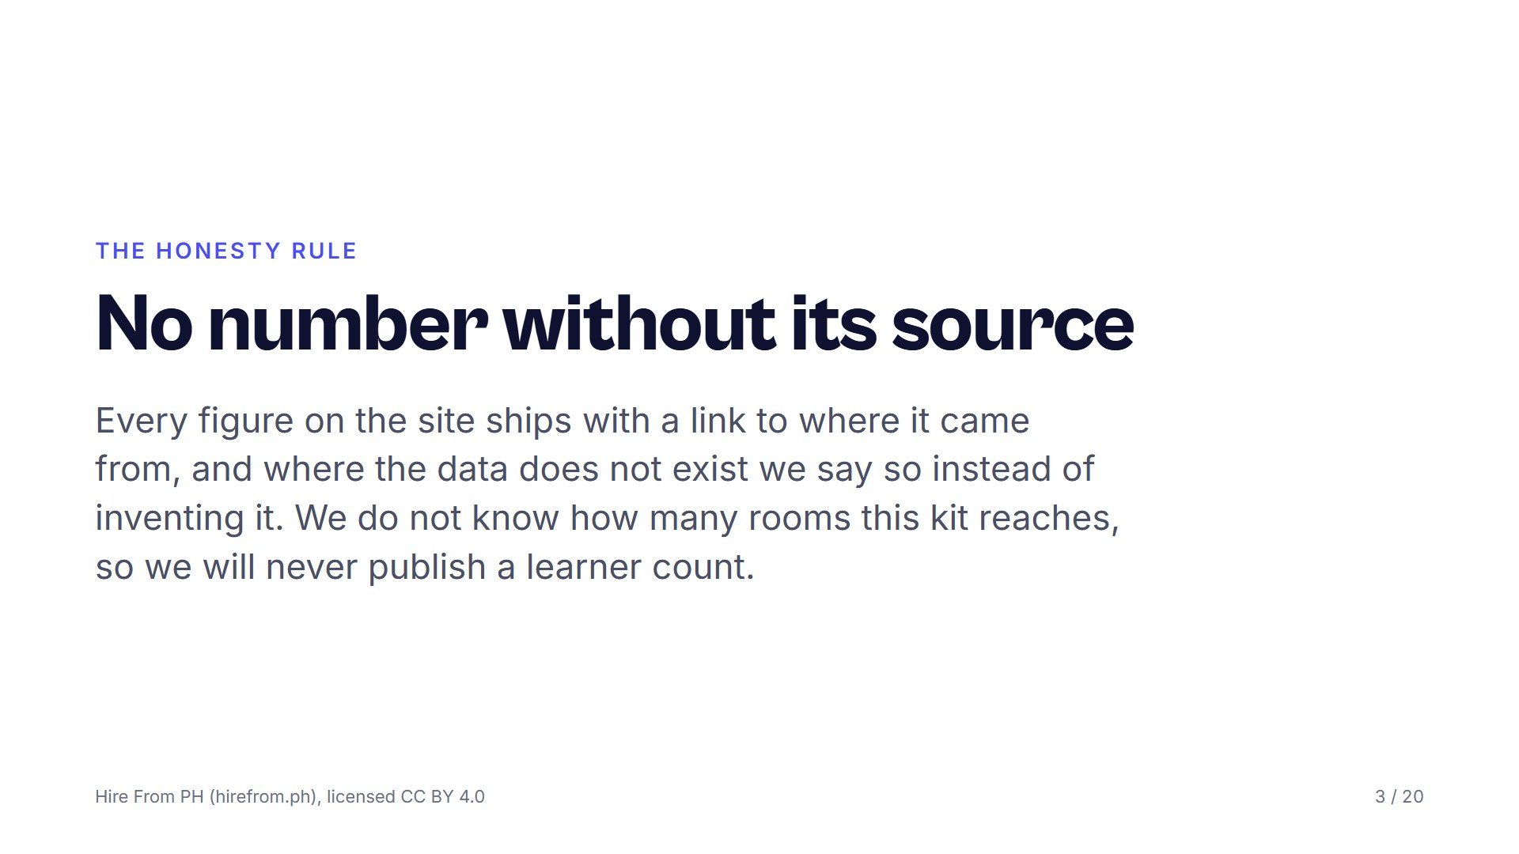
Notes:
We ask learners to write an integrity oath, so we hold ourselves to the same rule. Tell the room that any pay figure or market claim they meet on the site is an estimate with a citation, never a promise. Ask them when they last believed a number about online work without checking where it came from. That question is the seed of the VET method later.

Slide 4
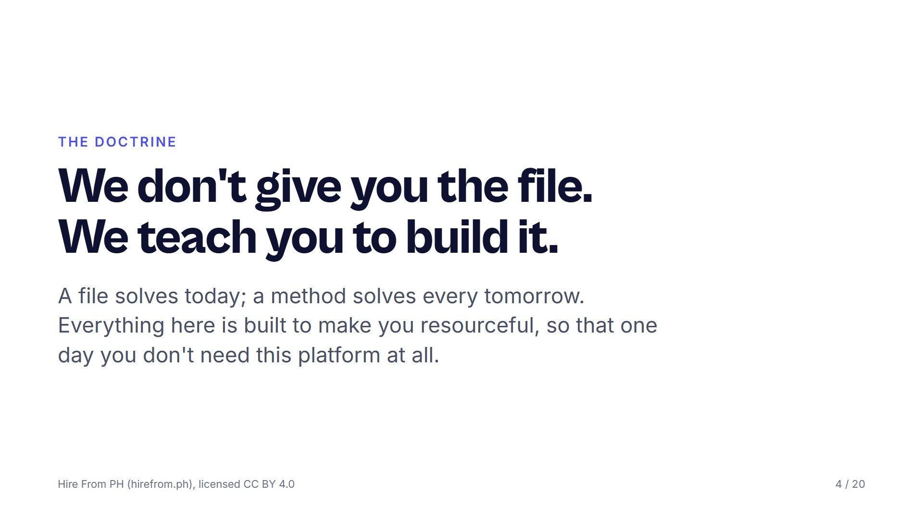
Notes:
A template makes you identical to every other applicant and stops helping the moment the job is slightly different. Someone who understands why a document is shaped the way it is can rebuild it for any situation, in any tool, from a blank page. Ask the room: if your resume disappeared tonight, could you rebuild it tomorrow, better? If not, they never had a resume, they had a download.

Slide 5
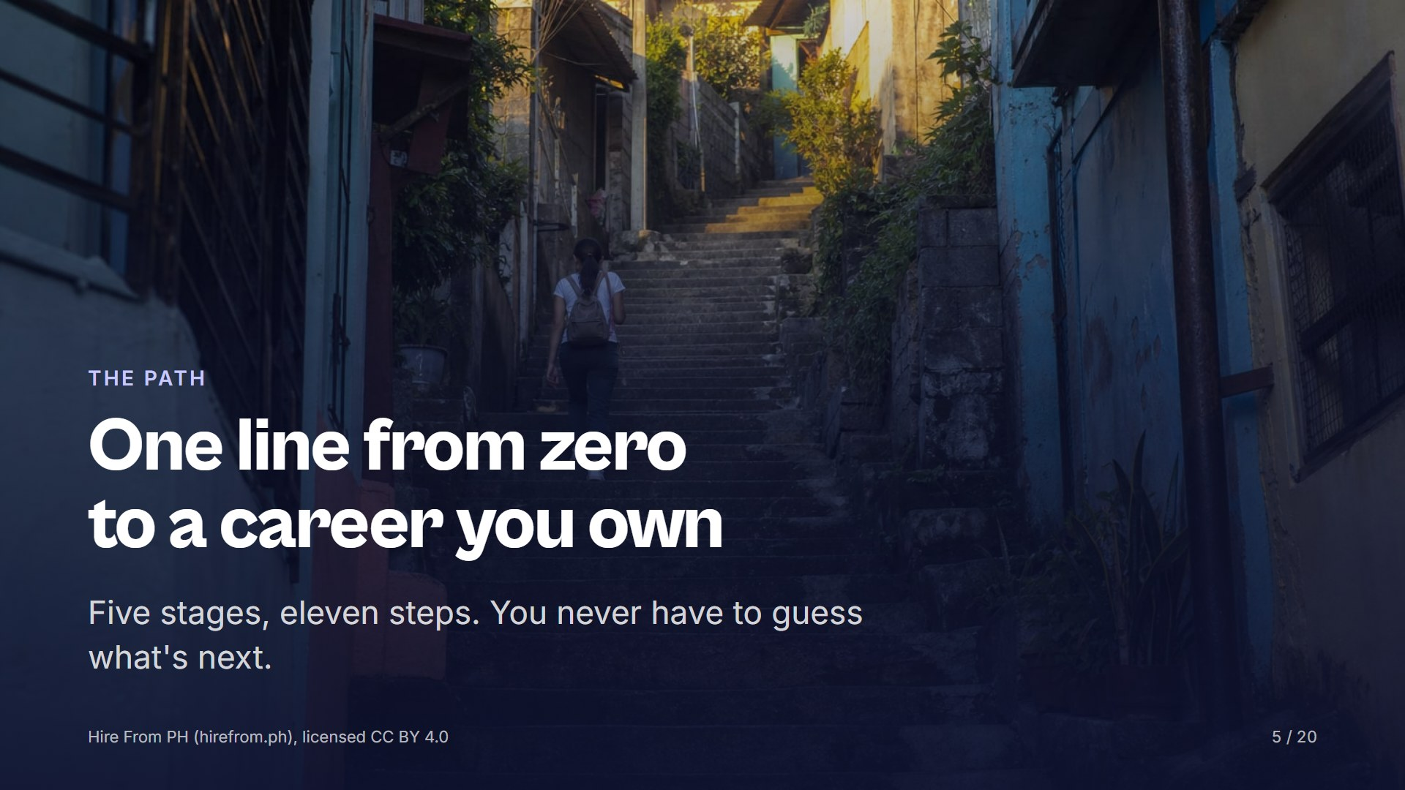
Notes:
This chapter shows the whole route before the methods, so the room knows where the methods get used. Say that every stage names who you are at that point, and that the line ends in independence, not employment. Ask people to place themselves on the line as you go; most rooms spread across the first three stages.

Slide 6
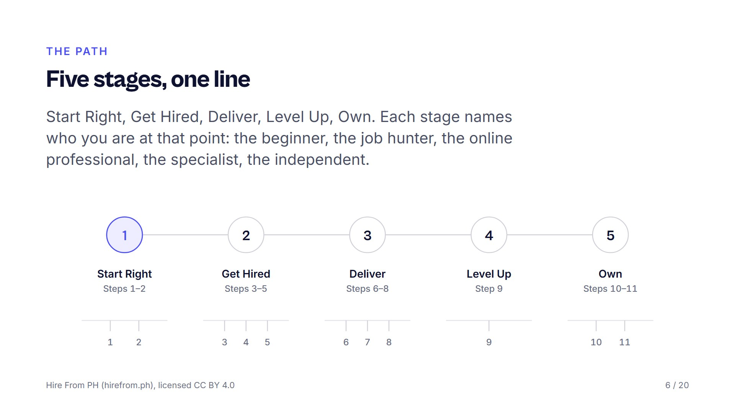
Notes:
Walk the map left to right and say one line per stage. Start Right needs no degree, no experience and no capital, only a working setup and one finished micro-task. Get Hired is a pipeline you build and track, not a bookmark list; Deliver is written systems; Level Up is one niche and a higher rate; Own is direct clients, a registered business, and a name people vouch for. Ask the room which stage they are in today and which one scares them.

Slide 7
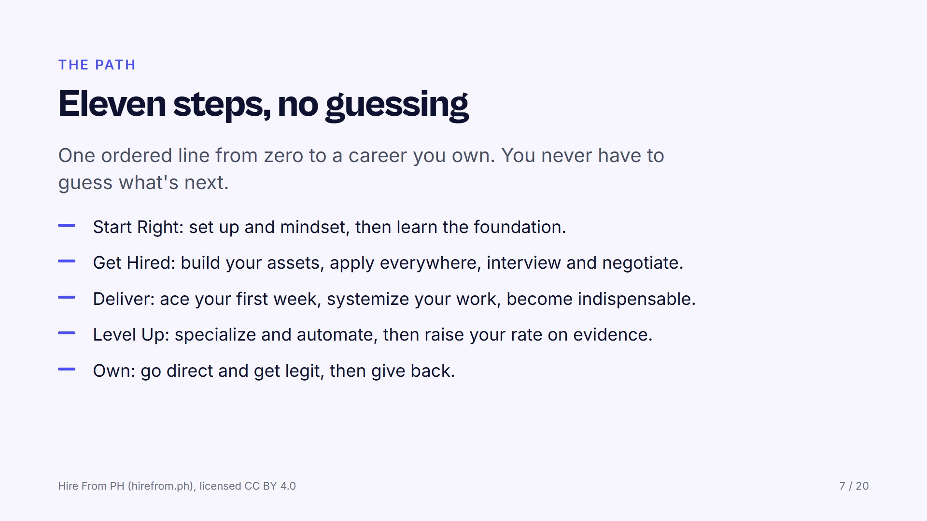
Notes:
Read the steps as a sequence, because the order is the point: nobody should be negotiating a rate before they have finished one real artifact. Point out that the last step is giving back, and that the platform counts itself successful when the person no longer needs it. Ask which single step each person would do this week if they had to pick one.

Slide 8
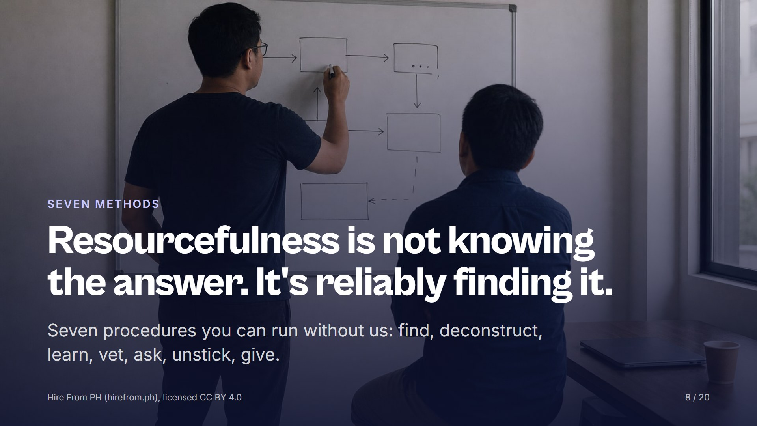
Notes:
Almost everything a person needs is public and costs nothing; the skill is knowing where to look and what to trust. Say that each of the next seven slides is a procedure, not advice, and that every one ends in a drill the participant does alone. Ask the room to pick the one they are worst at while you go through them. That is the one they take home.

Slide 9
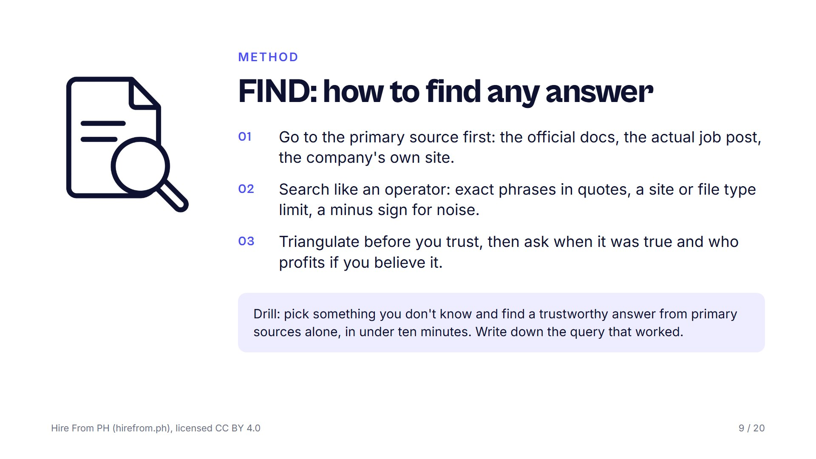
Notes:
Most people search like a customer; professionals search like an operator. Show one query live if you can: a job title in quotes, limited to one site, with a noise word subtracted. Say that if only one place says something, it is a rumour until a second and third independent source agree. Ask the room what the last thing they believed from a single confident source was.

Slide 10
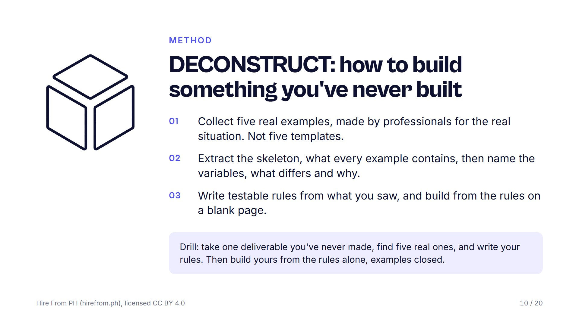
Notes:
You never need a template; you need five examples and the ability to see the pattern. The common structure across all five is not a style choice, it is the function. The differences are the judgment calls the participant will have to make for themselves. Ask the room which deliverable they have been avoiding because they had no template for it, and tell them that is their drill.

Slide 11
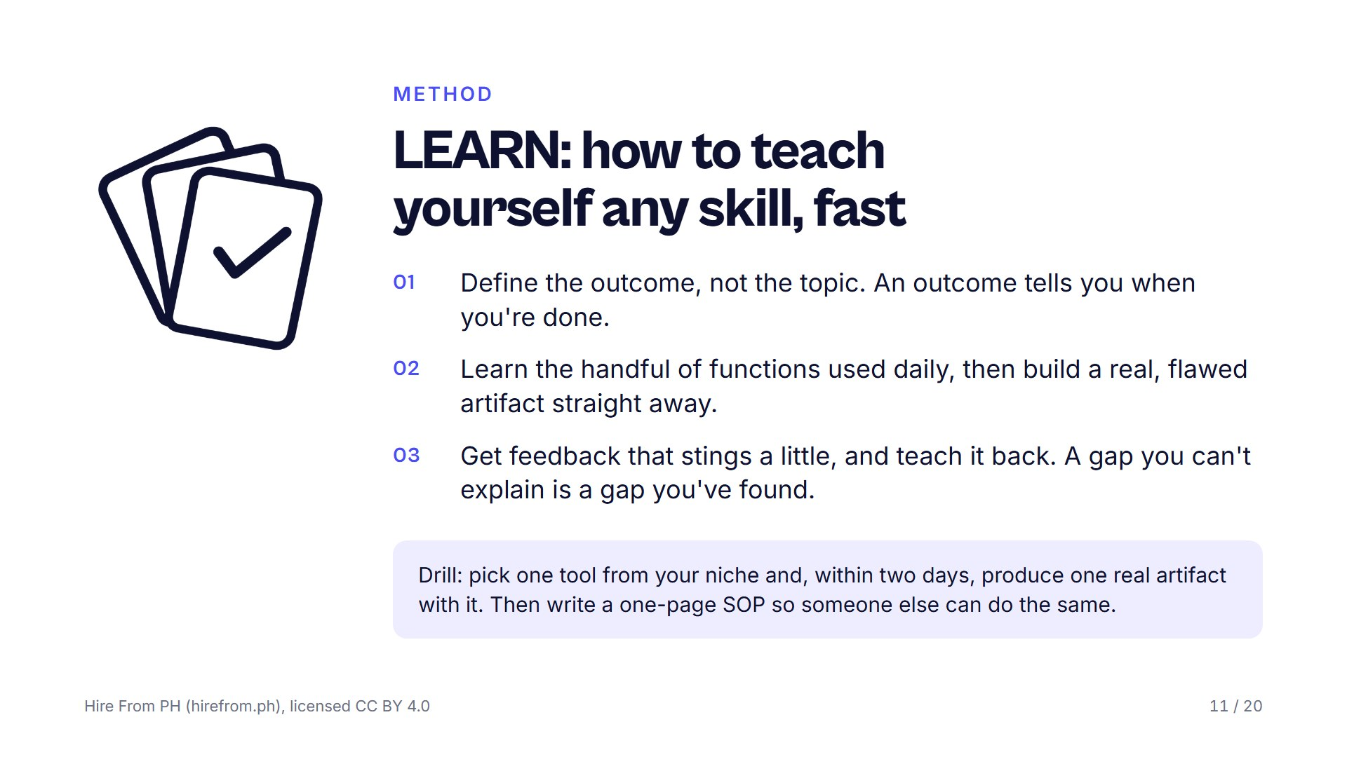
Notes:
Courses are optional; the ability to learn without one is not. Contrast learn QuickBooks with reconcile a month of real transactions without help, and ask which one tells you when you are finished. Warn the room against six hours of tutorial: twenty minutes of input, then build something broken, because the flaws tell you exactly what to learn next. Ask who in the room has taught someone a skill and what they discovered about their own gaps while doing it.

Slide 12
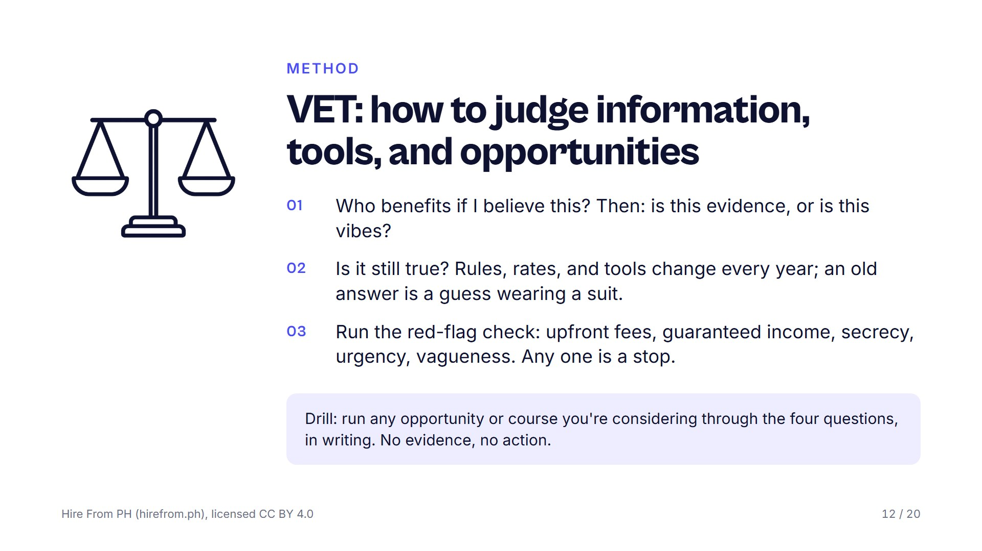
Notes:
Confidence is not accuracy, and advice usually arrives with an incentive attached. Numbers, named sources and dates are evidence; confidence, screenshots and lifestyle are not. Make the room say out loud that one hard stop ends it no matter how good the rest looks. Ask each person to name one thing they said yes to too quickly; everyone has one, so allow no shaming and no advice.

Slide 13
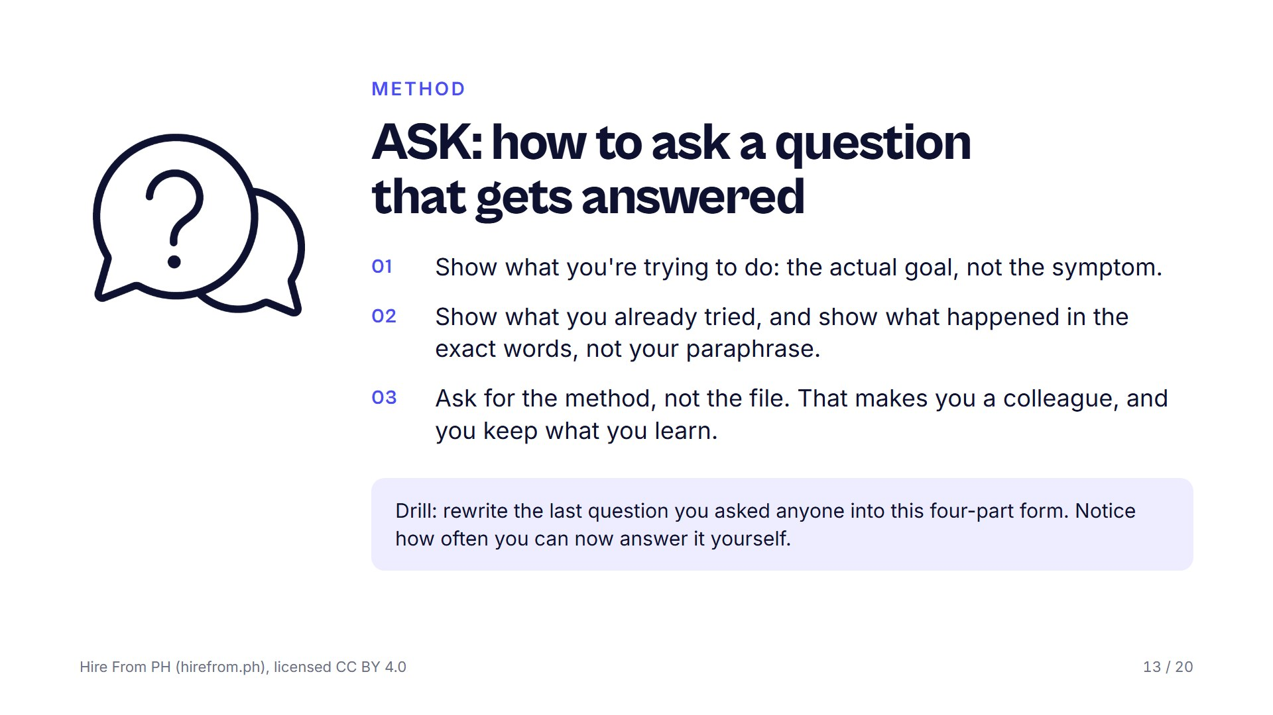
Notes:
A well-formed question gets a professional's help; a vague one gets ignored, everywhere. Read two questions aloud, a bare plea for help and a four-part one, and ask which they would answer with four minutes left and a full inbox. Refuse the phrase I tried everything, because it tells the reader nothing. Ask how many people have answered their own question while writing down what they already tried.

Slide 14
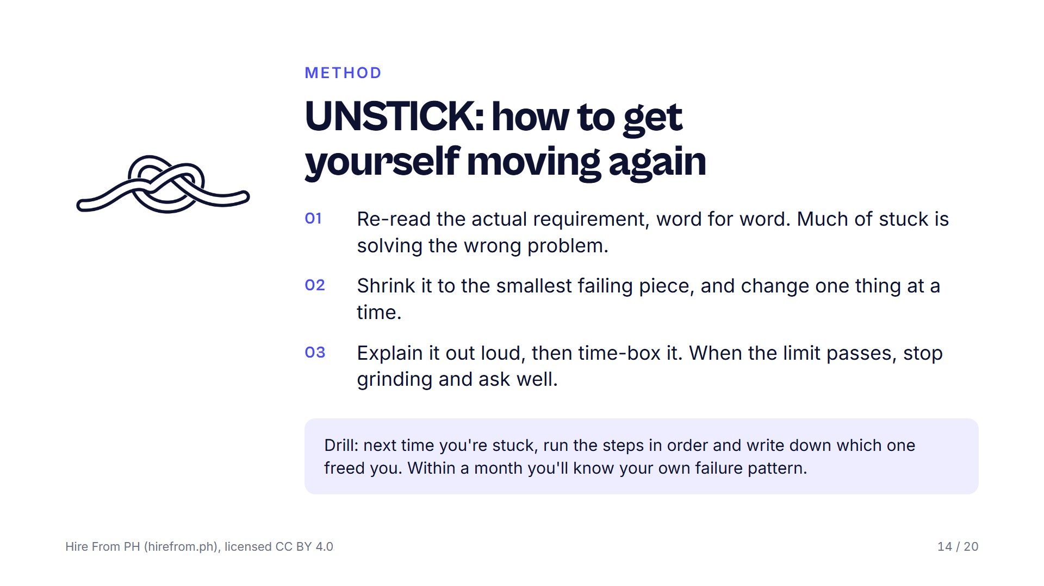
Notes:
Being stuck is a step, not a wall; every professional is stuck most of the day and simply has a procedure for it. Say that grinding past a hard time limit is ego, not work, and that asking well is what the limit is for. Point back to the ASK slide, since the two methods only work as a pair. Ask the room how long they usually stay stuck before telling anyone.

Slide 15
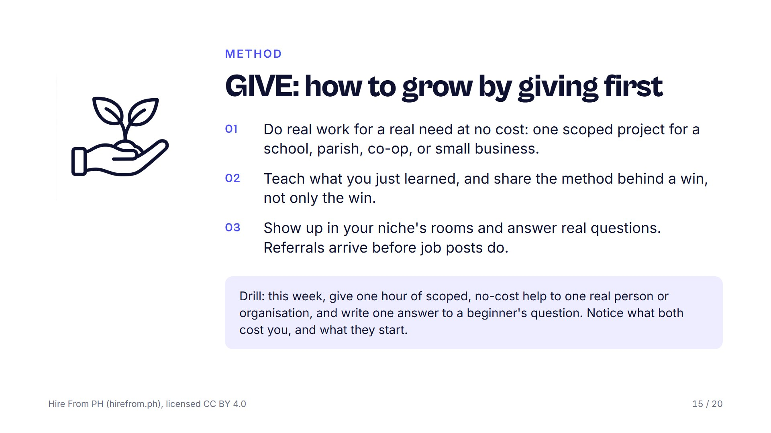
Notes:
The fastest way into any ecosystem is to put value into it before you ask anything from it. A small organisation gains more from a few of your hours than a large one ever would, so choose where the hours do the most good. Teaching is also the strongest test of understanding, which is why this method loops back to LEARN. Ask the room who they could help this week for free, and what they would write up afterwards.

Slide 16
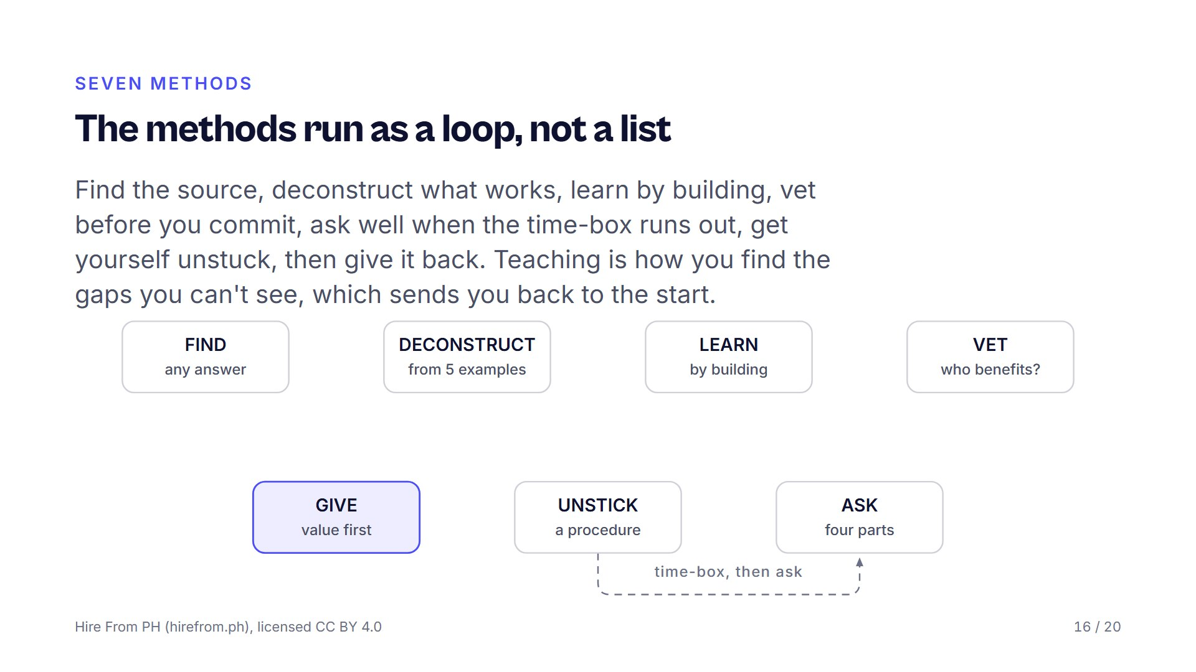
Notes:
Trace the loop with your hand. Point out the two joins the room will use most: UNSTICK hands off to ASK when the time limit passes, and GIVE hands back to LEARN because teaching exposes what you do not know. Say that nobody runs all seven in one day; they run whichever one the moment needs. Ask the room to name where on the loop they usually stall.

Slide 17
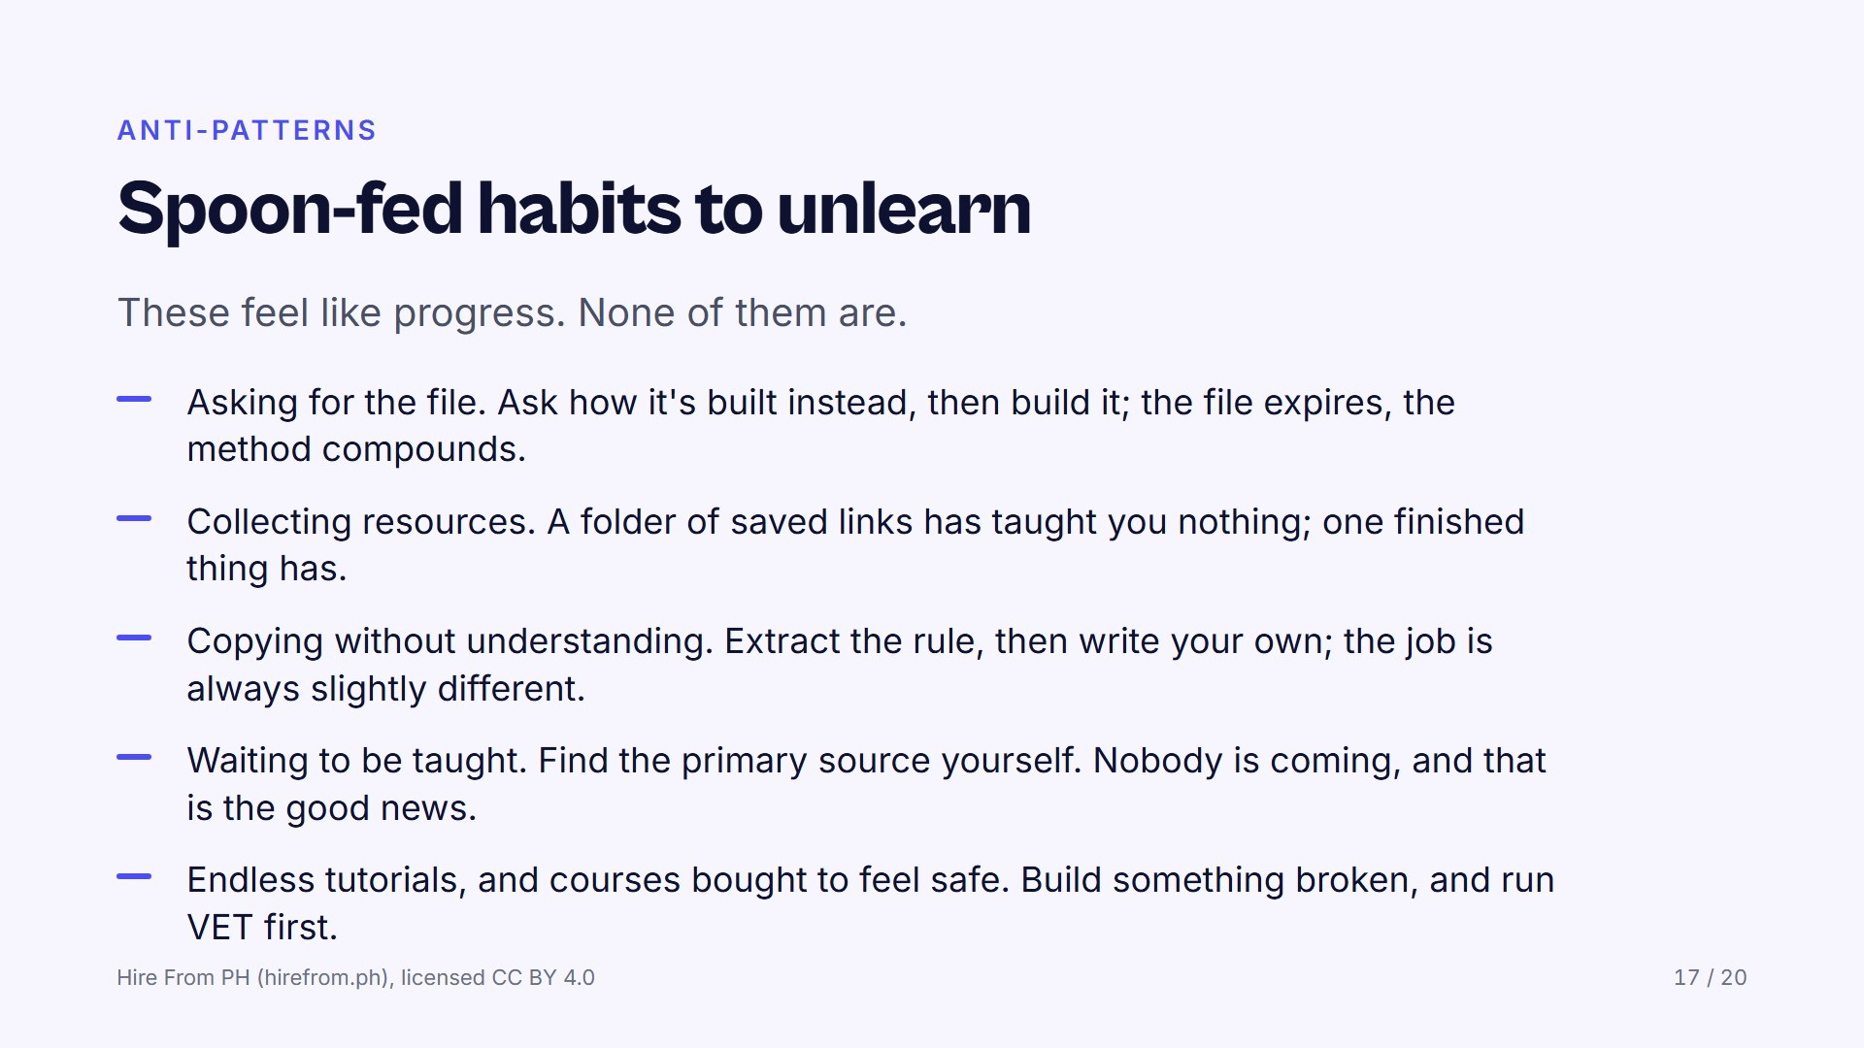
Notes:
Read each habit and let the room recognise itself; most people will see at least three of their own. Say that discomfort is not a signal to spend money, it is a signal to start. Ask everyone to write down the one habit they will drop this month and what replaces it. Do not ask them to share it; the written commitment is enough.

Slide 18
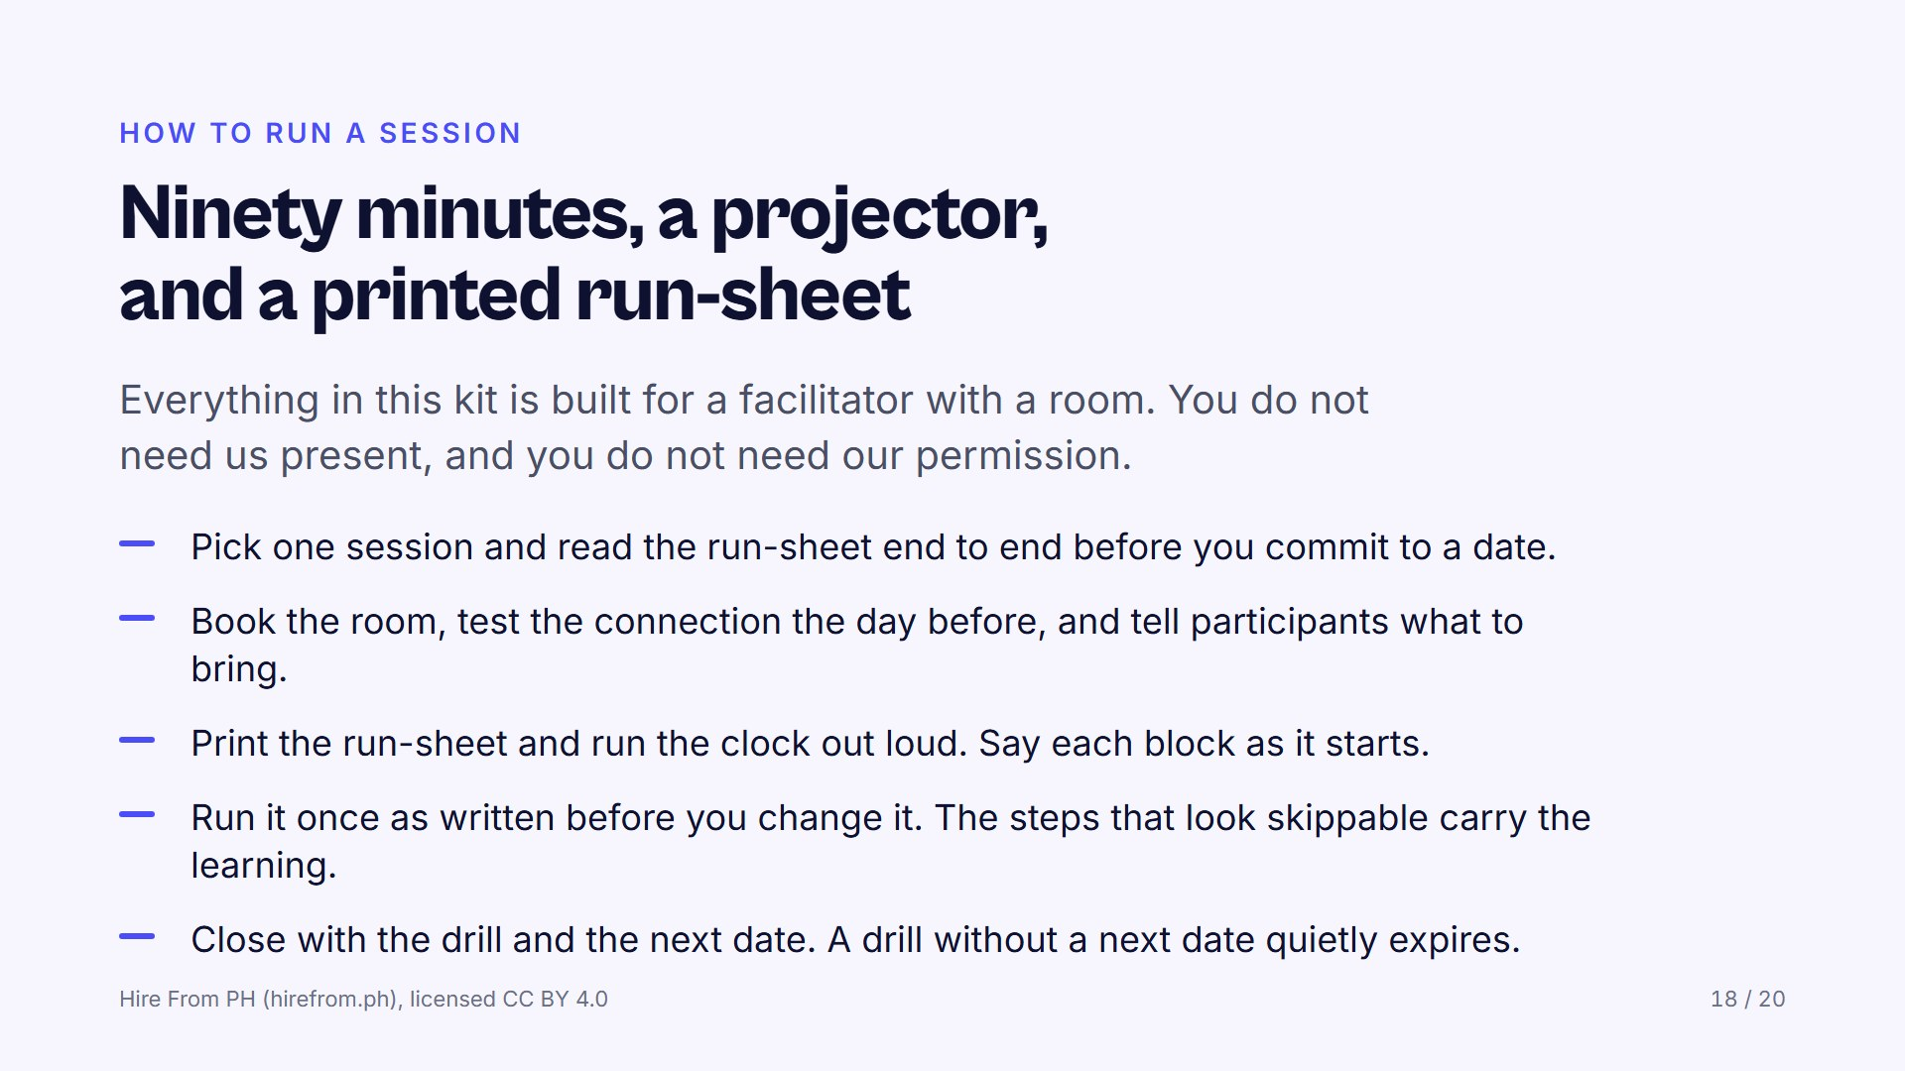
Notes:
If the room is full of facilitators, this is the slide to slow down on. Each session asks a different thing of the room: DECONSTRUCT needs argument, VET needs honesty, ASK needs quiet, so choose the one your group can carry today. Warn them that the blank-page build, the read-aloud and the written verdict look skippable and are the whole session; cut them and you have run a lecture. Ask who has a room and a date already, and who still needs one.

Slide 19
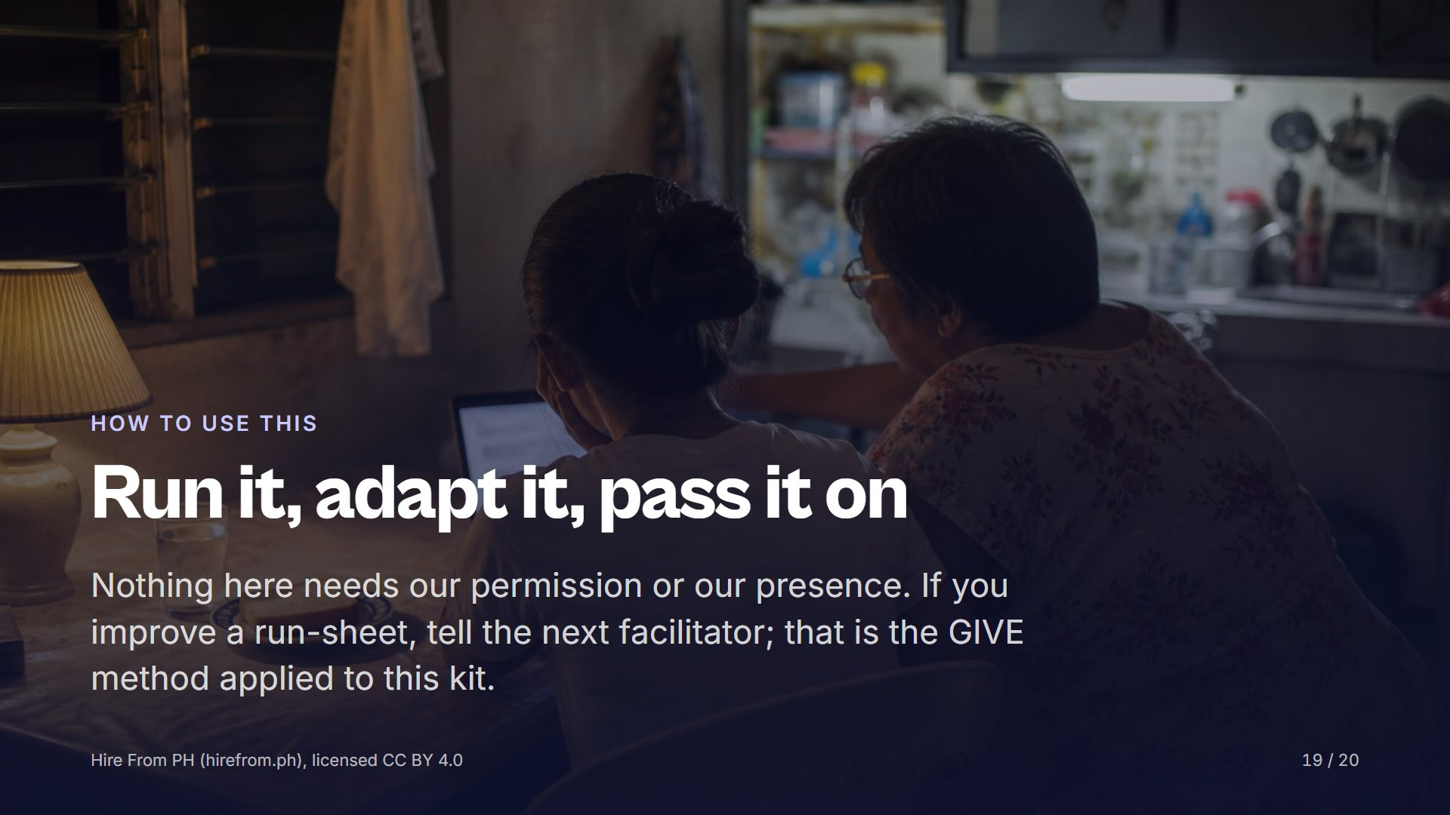
Notes:
Close by saying the proof of a session is in the room and in what participants build, not in a number on our page. Adapt after the first run, not before, and send what you changed to whoever runs it next. Ask each person to name the drill they are taking home and the date the group meets again, out loud, so the room can hold them to it.

Slide 20
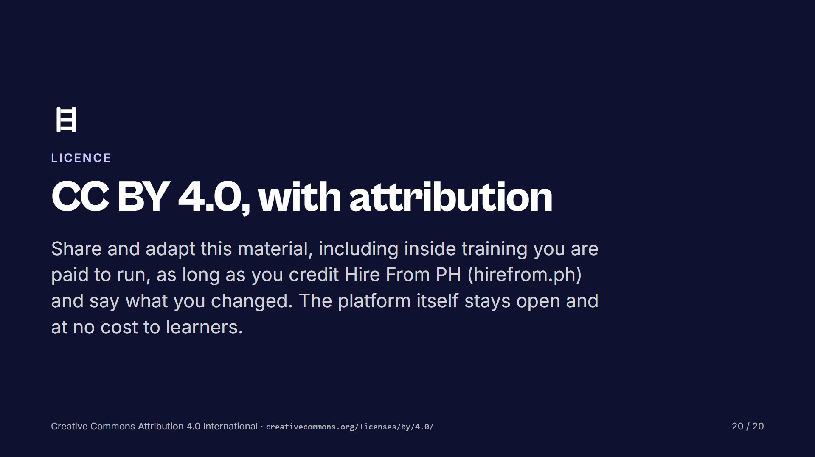
Notes:
State the licence in one breath: use it, change it, charge for your time if you must, credit the source and say what you altered. Say that the site itself stays free and asks for nobody's email. Leave this slide up while people write down their drill and the next date.

